Slide 1








CPSC 200
INTRO
SESSION
The Zoo, Linux Commands & VSCode

Slide 2
  THE Z0O
  A computer cluster at Yale running a version of Linux
    It is physically located in AKW and each machine is named after an animal, hence the name
  You can access the zoo from your local computer or other device using the shell
  Link to the Zoo website

Slide 3
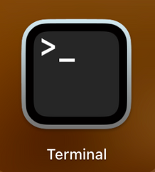

  THE SHELL
  A text based user interface for Unix systems
  Helps users and applications interact with each other, as well as other machines
  For the purpose of this class, we are using a shell to navigate through folders as you would on Finder or File Explorer and perform common tasks, like copying files, moving files, deleting files, etc.
  For Mac: you can use the built in terminal app
  For Windows: will need to install Windows Terminal if not already installed or you can use a built in terminal in a developing environment (like VSCode)

Slide 4
  HELPFUL SHELL COMMANDS
  ls - lists folders/files in your current directory
  pwd - displays current working directory
  cd *directory_name* - changes your working directory to the directory_name
    Think of directory name like folder name
  cd .. - changes directory one level higher (go-back)
  rm *file_name* - remove or delete file/folder
  mv *file_name* *destination* - move file to destination
  clear - visually clears your shell
  ctrl + c - terminate whatever is running right now
  scp *file_name* *source_directory*:~*target_file_path*
    secure copy of file/folder from source to target directory
  ssh *net_id*@node.zoo.cs.yale.edu - accessing your zoo account
    Note: if zoo is being buggy, try ssh to a specific zoo computer (hippo, tick, etc.)
  exit - exit the zoo

Slide 5
  ACCESSING THE ZOO
ssh *net_id*@node.zoo.cs.yale.edu
  Will prompt you to put in your netId password
    Note: when you type in your password it will not display you typing but trust it is working
    If your netId password is wrong, it’ll still prompt a duo push and it’ll look like it worked, so double check your password is correct if you are having problems accessing the zoo
  Duo Push Authentication

Slide 6
  RETRIEVING HW
1) ssh into the zoo
2) cd into the cpsc 200 directory (once in zoo, type cd /c/cs200/hws)
3) copy the hw file into your zoo directory or locally on your computer
  scp hw0 *netId*@node.zoo.cs.yale.edu:~*target_path*
  The target_path is where you want to save the file
    i.e. [...]@node.zoo.cs.yale.edu:~/myCS200Folder/hw0Stuff
      This example command assumes that in my zoo account I have a folder called “myCS200Folder” and within that folder I have another one called “hw0Stuff”. I am copying the hw to that location

Slide 7
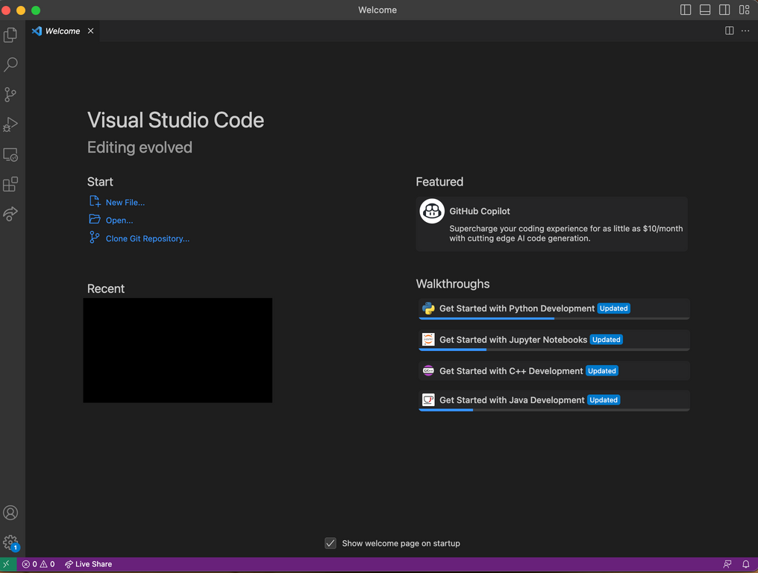
  SETTING UP VSCODE
Purpose of this is to set up your VSCode so you can access the Zoo via the developing environment
1) Download Visual Studio Code
2) Open up VSCode, download Remote SSH extension
3) Click the “><” button on the bottom left corner
4) Click “Connect to Host”
5) Click “Add New SSH Host”
6) Enter “[netID]@node.zoo.cs.yale.edu”
7) Now when you want to go to zoo, you can just click on this button and press the zoo path you put in

Slide 8
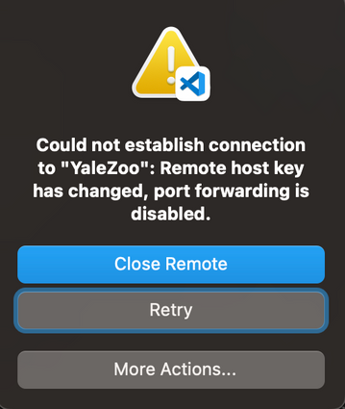
  TROUBLESHOOTING ZOO
  Sometimes the zoo is buggy, you can go to the zoo website to see if there are specific computer nodes that are unavailable/buggy
  When in doubt, try again (sometimes doing it 4 times lets you in)
  If you see this pop up, or see the “WARNING REMOTE HOST IDENTIFICATION HAS CHANGED” error in the output, troubleshoot by fixing the known_host issue (next slide)

Slide 9
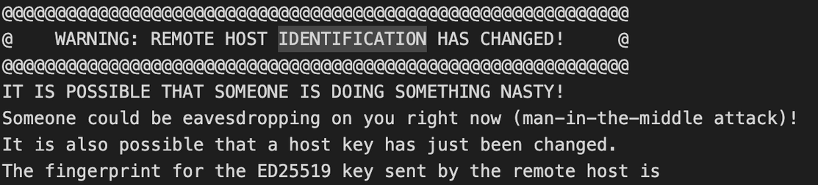
  HOST KEY TROUBLESHOOTING
1) When you see the pop up, click More Actions
2) Go to the “Output” tab and scroll to find where it tells you the correct host key is:
3) Copy the long key, it’s going to be something like a long string of letters and numbers
4) Open the terminal application
5) enter “cd .ssh”
6) enter “vim known_hosts” (Vim Commands Cheat Sheet)
7) enter “i” - you can now make edits to the file
8) Navigate to where it has long key fingerprints, and replace whatever is already written with the copied key
9) Once done, press “esc” then enter “:wq” to save the changes and exit
10) try ssh again, if prompted asking if you want to continue connecting, enter yes

Slide 10
  HELPFUL LINKS
  WHEN YOU RUN INTO ZOO PROBLEMS
  Zoo Info by Prof. Aspnes
  Reference this doc for Unix on Windows
    Helpful video: 1
  Unix tutorial for beginners
  Go to the zoo website and submit a support ticket!
  They are usually very fast about getting back to you
  FOR HELP
  Post on ED, fastest way to get questions answered!

