Slide 1
CS200 - Review
Midterm 2

Slide 2
Agenda
General study advice
Decorators
Exceptions
Python virtual machine
Queues and stacks
UNIX - Principle 3 or Questions

Slide 3
General study advice
Go over hw4 and hw5 if you’ve completed them!
Look at your implementations for the data structures in particular
Carefully go over the solutions to the practice midterm if you haven’t already
Review these slides before the exam
If you understand these, you should be able to complete the midterm comfortably.

Slide 4
Decorators

Slide 5
Decorator
A function that takes another function as an argument, and returns a new function that modifies the input function.
For the exam:
Defining decorators
Using the *args keyword
Modifying functions inside a decorator
The __wrapped__ property of a decorator

Slide 6
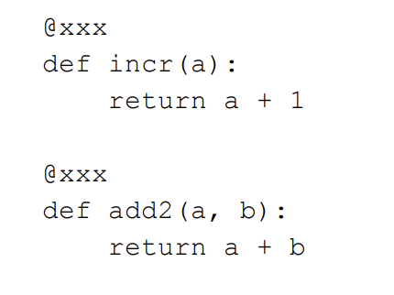
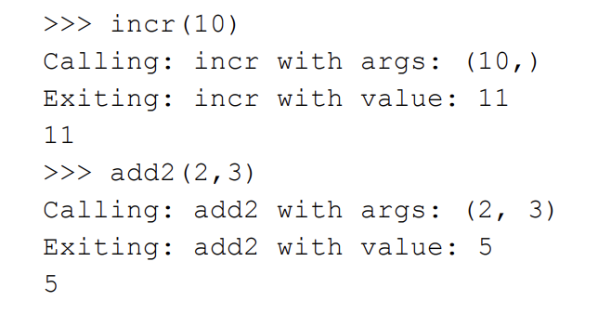
Decorator - example

Slide 7
Decorator - example
*args represents any and all arguments that the function g can accept
Calling the wrapped function with any arguments passed in
IMPORTANT: Remember that the decorator has to return the new function that modifies the initial function’s behavior, even if the initial function doesn’t return anything

Slide 8
The __wrapped__ property
A property that can be accessed on a decorated function that returns the non-decorated version of the function.
incr.__wrapped__ is the default implementation of incr without the print functionality.
I.e:
Calling incr.__wrapped__(5) will output 6 without the print functionality.

Slide 9
Exceptions

Slide 10
Important exceptions
Python has an extremely wide range of exceptions - make sure you familiarize yourself with the standard exceptions!
Import Errors
Name Errors (undefined)
File Errors
Index Errors
Key Errors
You can also raise your own exceptions!
raise Exception(“My exception”)
Try/except pattern
Code execution stops at the line that raised the error
We can catch specific exceptions to allow for custom error handling

Slide 11
Python Virtual Machine

Slide 12
What you need to know
Writing python procedures from bytecode
Variable assignment
Conditionals
Functions
Writing bytecode generated from Python

Slide 13
Variable assignment in Bytecode
Index of instruction
Instruction (opcode)
Oparg
Resolved argument
0 LOAD_CONST 0 (3)
2 STORE_FAST 0 (A)
4 LOAD_CONST 1 (5)
6 STORE_FAST 1 (B)
A = 3
B = 5
Notes:
LOAD_CONST - Takes oparg that represents the position of a constant in the constants array
STORE_FAST - Takes index of variable in variable array (actually called a reference, but for simplicity's sake, think of an array of variables
Index of instruction corresponds directly to the offset. Don’t worry too much about this - to play it safe, for the exam just use increments of 2 for each instruction and you should be fine.

Slide 14
Variable assignment in Bytecode
0 LOAD_CONST 1 (6)
2 STORE_FAST 0 (X)
4 LOAD_CONST 2 (4)
6 STORE_FAST 1 (Y)
X = 6
Y = 4

Slide 15
Conditionals
0 LOAD_CONST 0 (6)
2 STORE_FAST 0 (X)
4 LOAD_CONST 1 (5)
6 STORE_FAST 1 (Y)
8 LOAD_FAST 0 (X)
10 LOAD_FAST 1 (Y)
12 BINARY_MULTIPLY
14 POP_JUMP_IF_FALSE 18
…
18 LOAD_CONST 2 (7)
20 LOAD_FAST 0 (X)
X = 6
Y = 5
if x * y:
………
else:
X = 7

Slide 16
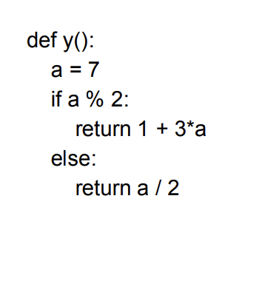
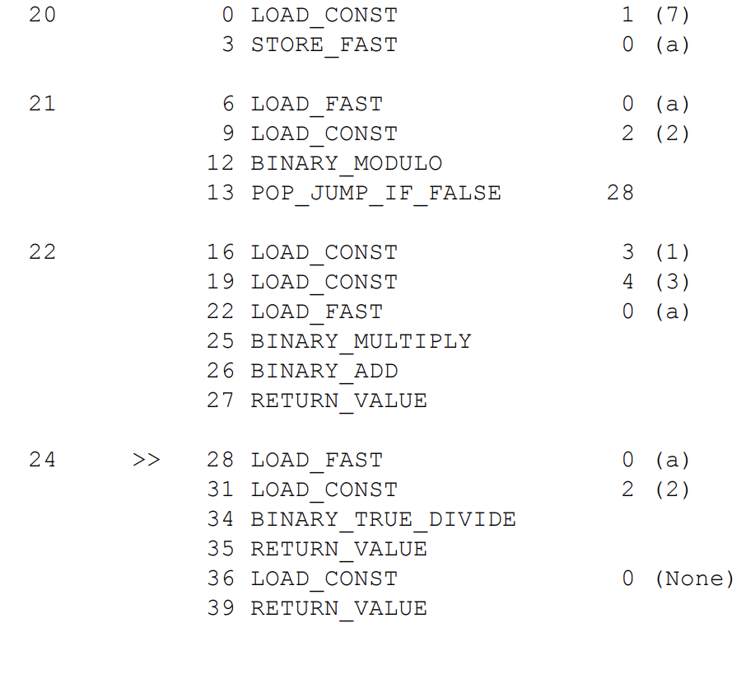
Functions

Slide 17
General approach to solving bytecode problems
Scan through the code and get a sense of variables and constants
Keep a list of constants and variables on a rough piece of paper in the order they appear
Break down each line of code into its corresponding instructions
Ensure you refer to your constructed list of constants and variables to get the opcodes right
Run the code through in your head.
Does it load the right values at the right time?
Are you using the correct instructions?

Slide 18
Queues and Stacks

Slide 19
Queues and stacks
Both are data structures that allow us to store/add/remove data in a certain order
Queue
First in, first out
Can be implemented using stacks
Stack
First in, last out

Slide 20
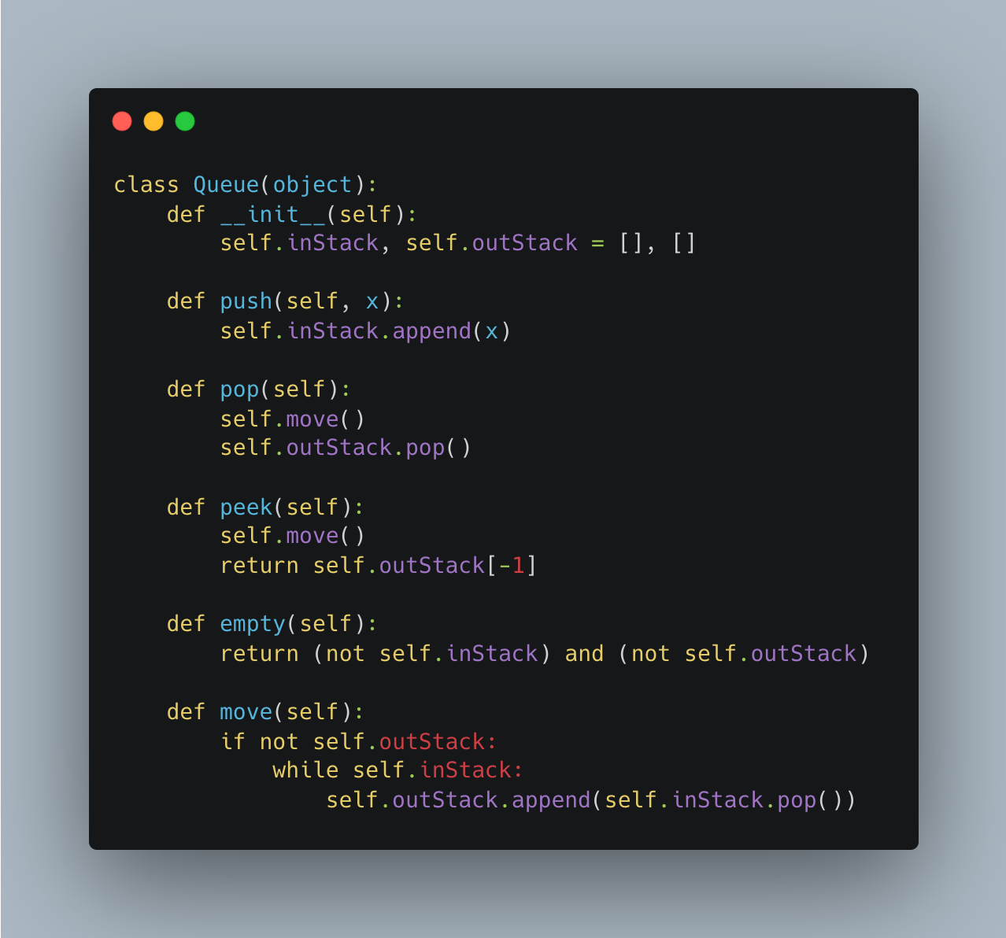
Implementing queues using stacks

Slide 21
Questions?

Slide 22
UNIX

Slide 23
How can I get better at UNIX?
1) UNIX tutorial on the Zoo! ssh into the Zoo; then in your home folder, type the following command: python3 /c/cs201/www/unixtutorial.py
2) Practice typing commands on the Zoo
General tips:
Be familiar with the output of each command (important in context of the transcript!)

Slide 24
A few scenarios
We will mostly focus on principle 3 during this review session, but be sure to review principles 1 & 2 as well!

Slide 25
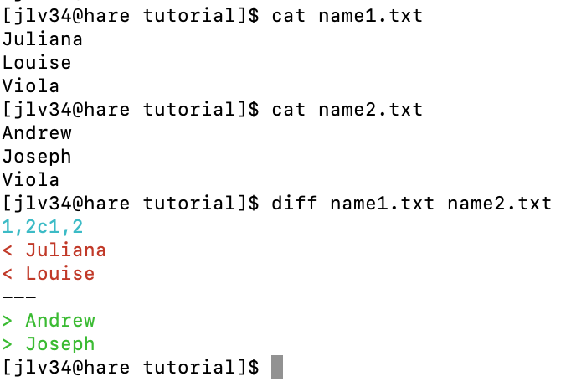
scenario 1

Slide 26
scenario 1

Slide 27
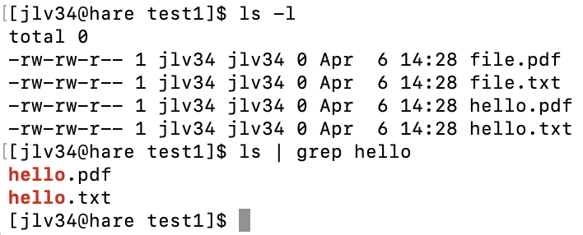
scenario 2

Slide 28
scenario 2

Slide 29
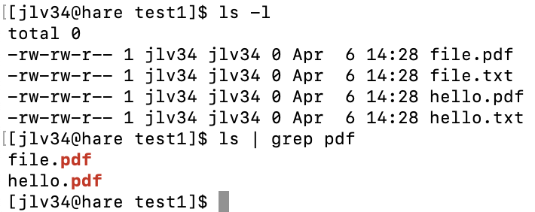
scenario 3

Slide 30
scenario 3

Slide 31
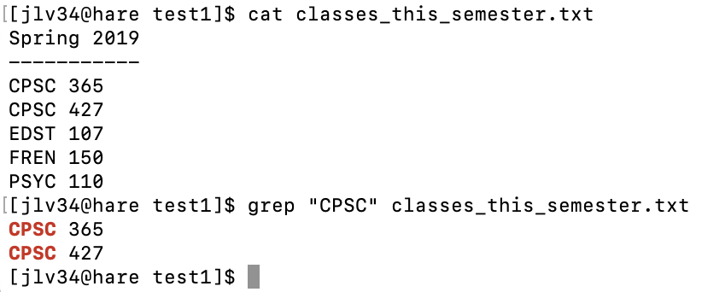
scenario 4

Slide 32
scenario 4

Slide 33
scenario 5

Slide 34
scenario 5

Slide 35
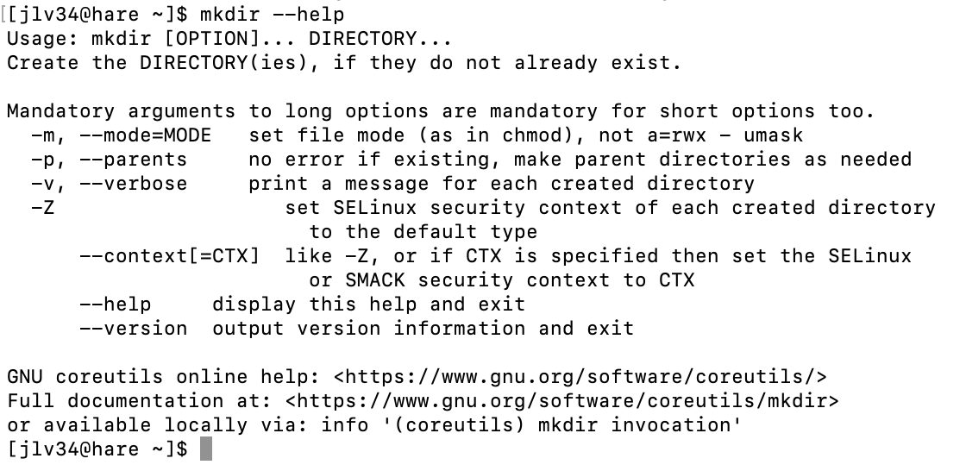
scenario 6

Slide 36
scenario 6

Slide 37
scenario 7

Slide 38
scenario 7

Slide 39
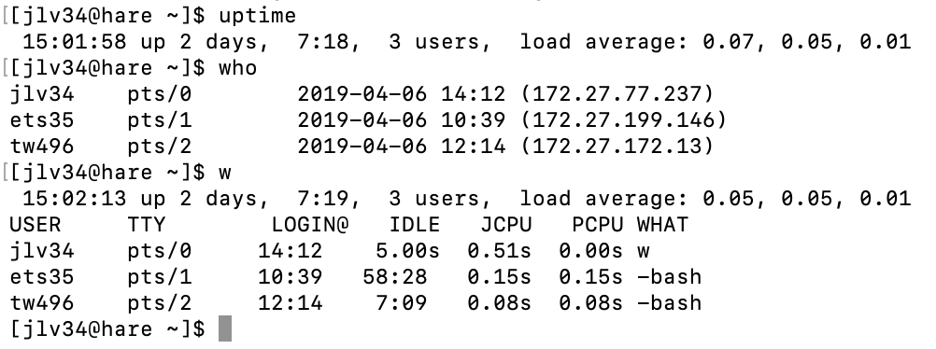
scenario 8

Slide 40
scenario 8

Slide 41
scenario 9

Slide 42
scenario 9

Slide 43
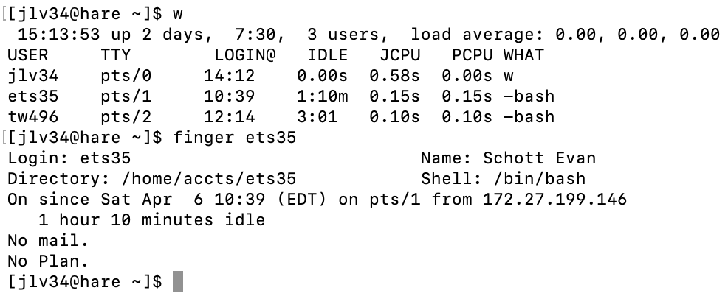
scenario 10

Slide 44
scenario 10

Slide 45
Input/output redirection
touch new.txt
echo hello > new.txt
echo goodbye.txt > new.txt
?
echo goodbye2 >> new.txt
?

