Slide 1

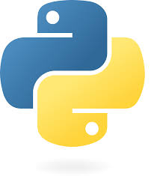
CS 201 Midterm 2 Review
Fall 2024

Slide 2
Agenda
Midterm Logistics
Reviewing resources
Unix
Python review
Python Virtual Machine (PVM)
OOP Methods and Basic Data Structures (Stacks, Queues, and Hash Tables)
Exceptions
Iterators
Decorators
Recursion
Final Tips

Slide 3
Agenda
Midterm Logistics
Reviewing resources
Unix
Python review
Python Virtual Machine (PVM)
OOP Methods and Basic Data Structures (Stacks, Queues, and Hash Tables)
Exceptions
Iterators
Decorators
Recursion
Final Tips

Slide 4
Logistics - Midterm 2
Thursday, November 7th at 7pm in ML 211
2-hour hand-written exam
No computers, notes, or books
For special accommodations, please reach out to Professor Slade ASAP

Slide 5
Agenda
Midterm Logistics
Reviewing resources
Unix
Python review
Python Virtual Machine (PVM)
OOP Methods and Basic Data Structures (Stacks, Queues, and Hash Tables)
Exceptions
Iterators
Decorators
Recursion
Final Tips

Slide 6
Available Resources
The Basics → CPSC 200 – Course Site; This include the lecture notes
Google’s Python Class Intro → Overview
"THE" Python Guide
Practice material for Midterm 2
Practice Exam / Solutions
UNIX Transcript / Solutions
ssh into the Zoo; then in your home folder, type the following command:
python3 /c/cs201/www/unixtutorial.py
Ed Discussion board → Ask questions and call out typos (great way to earn Errata points)
Reviewing problem sets, especially Pset 4 (hint, hint), and each other (it never hurts to make study groups)!

Slide 7
Agenda
Midterm Logistics
Reviewing resources
Unix
Python review
Python Virtual Machine (PVM)
OOP Methods and Basic Data Structures (Stacks, Queues, and Hash Tables)
Exceptions
Iterators
Decorators
Recursion
Final Tips

Slide 8
UNIX will cover through Principle Three
UNIX tutorial on the Zoo → ssh into the Zoo; then in your home folder, type the following command:
python3 /c/cs201/www/unixtutorial.py
2) Another resource for additional practice is Tutorial Point’s Unix/Linux Tutorial
https://www.tutorialspoint.com/unix/index.htm
General tips:
Take the time to work on the principles. Even if you completed the first two, go back and practice.
Notes:
You need to know principles 1 & 2 for this midterm

Slide 9
Two examples of UNIX scenarios

Slide 10
UNIX
Principles 1-3 → Some highlights of III:
diff
touch
grep
file
whoami
id
uptime
Difference between piping and redirection:
Piping (|) takes output and sends to to another program
Redirection (>, &>, 2>, >>,etc.) takes output and sends to to either a file or a stream.

Slide 11
UNIX
[crb84@scorpion tmp]$ ls
Friday test test_01 test_02
[crb84@scorpion tmp]$ XXXX1
[crb84@scorpion tmp]$ ls
files Friday test test_01 test_02
[crb84@scorpion tmp]$ ls > files_new
[crb84@scorpion tmp]$ XXXX2
0a1,3
> files
> files_new
> Friday
[crb84@scorpion tmp]$

Slide 12
UNIX
[crb84@scorpion tmp]$ ls
Friday test test_01 test_02
[crb84@scorpion tmp]$ ls | grep test > files
[crb84@scorpion tmp]$ ls
files Friday test test_01 test_02
[crb84@scorpion tmp]$ ls > files_new
[crb84@scorpion tmp]$ diff files files_new
0a1,3
> files
> files_new
> Friday
[crb84@scorpion tmp]$

Slide 13
UNIX
[crb84@scorpion tmp]$ ls -l
total 0
[crb84@scorpion tmp]$ XXXX1
[crb84@scorpion tmp]$ ls -l
total 4
-rw-rw-r-- 1 crb84 crb84 204 Apr 15 21:49 1
[crb84@scorpion tmp]$ XXXX2
total used free shared buff/cache available

Slide 14
UNIX
[crb84@scorpion tmp]$ ls -l
total 0
[crb84@scorpion tmp]$ free > 1
[crb84@scorpion tmp]$ ls -l
total 4
-rw-rw-r-- 1 crb84 crb84 204 Apr 15 21:49 1
[crb84@scorpion tmp]$ head -n1 1
total used free shared buff/cache available

Slide 15
Take the time to complete the tutorial This is the best way to learn the content

Slide 16
Agenda
Midterm Logistics
Reviewing resources
Unix
Python review
Python Virtual Machine (PVM)
OOP Methods and Basic Data Structures (Stacks, Queues, and Hash Tables)
Exceptions
Iterators
Decorators
Recursion
Final Tips

Slide 17
Python... so far
Midterm 1 covered:
Procedure Examples
Regular Expressions
Python Expressions
Recursion
Comprehensions
Object-oriented Programming
For Midterm 2, the scope include:
Python Virtual Machine (PVM), OOP Methods, Basic Data Structures (Stacks, Queues, and Hash Tables), Exceptions, Iterators, Decorators, and Recursion.
Notes:
You need to know principles 1 & 2 for this midterm

Slide 18
Agenda
Midterm Logistics
Reviewing resources
Unix
Python review
Python Virtual Machine (PVM)
OOP Methods and Basic Data Structures (Stacks, Queues, and Hash Tables)
Exceptions
Iterators
Decorators
Recursion
Final Tips

Slide 19
Python Virtual Machine (PVM)
1. What is it?
The PVM is the core component of the Python interpreter
When you write Python code, it’s first converted into bytecode, a lower-level, platform-independent representation of your code
This bytecode is then executed by the PVM, which interprets each bytecode instruction and performs the corresponding operations on your machine
Essentially, the PVM acts as the bridge between Python code and your hardware

Slide 20
Python Virtual Machine (PVM)
2. Why does it matter?
Understanding the PVM is important because it helps explain Python’s behavior, performance, and certain limitations. Here are a few reasons why it’s significant:
Portability: Bytecode can run on any machine with a Python interpreter, making Python code highly portable
Memory Management: The PVM handles memory allocation, garbage collection, and resource cleanup, so understanding it helps developers write efficient, memory-safe programs
Execution Flow: Knowing that Python code goes through a compile phase (to bytecode) and then an interpret phase (by the PVM) helps with understanding debugging, performance optimization, and troubleshooting runtime errors

Slide 21
Python Virtual Machine (PVM)
3. Where can you expect to see this?
Debugging and Profiling Tools: Tools like pdb (Python debugger) and profiling libraries interact with the PVM to monitor and manipulate Python code execution. If you’re troubleshooting code performance or runtime errors, you’re indirectly working with the PVM
Compiled Bytecode Files: You might see .pyc files generated by Python. These are cached bytecode files created to speed up subsequent executions of the same script
Error Messages: Certain error messages refer to bytecode or the internals of the PVM, especially if you're dealing with complex or low-level programming in Python

Slide 22
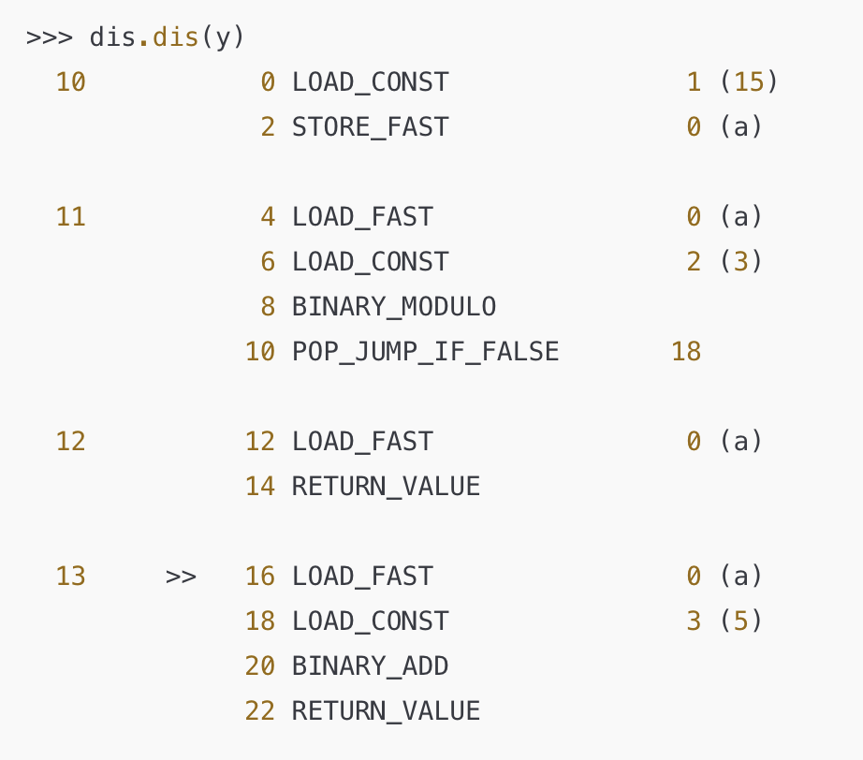
Example 1: PVM
Define a Python function y() that generates the following bytecode in Python version 3.10:

Slide 23
How to approach?
To approach this type of bytecode-related problem, follow these steps:
Understand the Bytecode Instructions: Analyze each bytecode line and understand what operation it performs (e.g., LOAD_CONST, BINARY_MODULO, POP_JUMP_IF_FALSE). Recognize common instructions for assignments, arithmetic operations, and conditionals
Identify Control Flow and Conditions: Look for jump instructions like POP_JUMP_IF_FALSE to determine where the code branches or checks conditions, helping you identify if-else or loop structures
Map Bytecode to Python Constructs: Based on the bytecode, infer the high-level Python operations (e.g., variable assignments, conditional statements) that would produce the same bytecode
Determine Variable Values and Expressions: Identify the constants and operations (like 15 and % 3 in the example) and how they relate to the bytecode operations
Write the Python Function: Draft a function that matches the inferred structure, ensuring it uses the correct constants, operators, and control flow to generate the expected bytecode

Slide 24
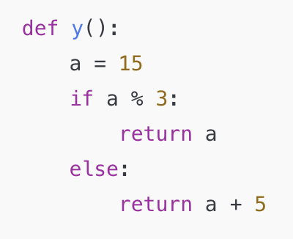
Answer:
The function y() that produces this bytecode is:
Variable Initialization: The line a = 15 assigns the value 15 to a. This corresponds to LOAD_CONST and STORE_FAST instructions in the bytecode
Modulo Condition: The if a % 3: line checks if a modulo 3 is non-zero. If it is, the condition is true, and a is returned directly. This matches the LOAD_FAST, BINARY_MODULO, and POP_JUMP_IF_FALSE instructions
Return Statements:
If the condition is true (meaning a modulo 3 is non-zero), the function returns a directly, which corresponds to the RETURN_VALUE instruction at line 12
If the condition is false (meaning a modulo 3 is zero), the function returns a + 5. This is represented by LOAD_FAST, LOAD_CONST, BINARY_ADD, and RETURN_VALUE instructions

Slide 25
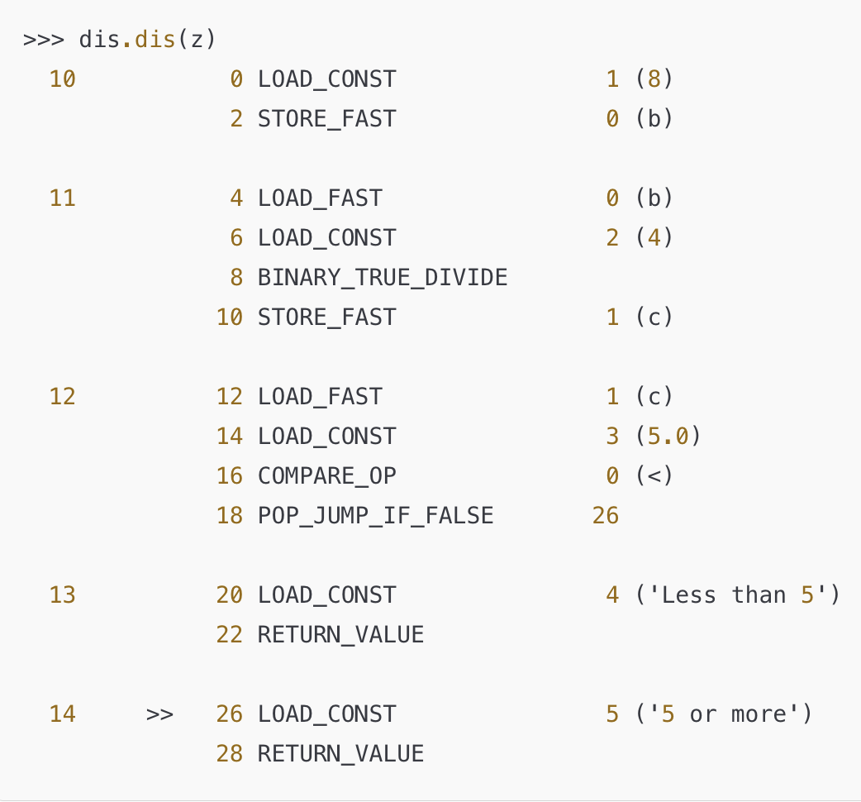
Example 2: PVM
Define a Python function y() that generates the following bytecode in Python version 3.10:

Slide 26
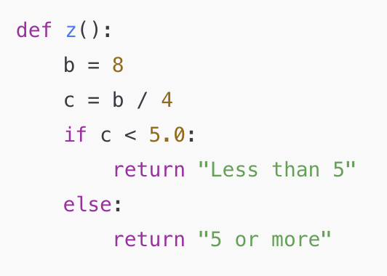
Answer:
The function z() that produces this bytecode is:
Variable Initialization: b = 8 assigns the value 8 to b, which corresponds to LOAD_CONST and STORE_FAST instructions in the bytecode
Division Operation: c = b / 4 divides b by 4 and stores the result in c, corresponding to the BINARY_TRUE_DIVIDE and STORE_FAST instructions
Comparison Condition: if c < 5.0: checks if c is less than 5.0. This comparison is represented by COMPARE_OP with the < operation.
Return Statements:
If c < 5.0 is true, the function returns "Less than 5", matching the RETURN_VALUE instruction at line 20
If c >= 5.0, the function returns "5 or more", represented by the RETURN_VALUE instruction at line 28

Slide 27
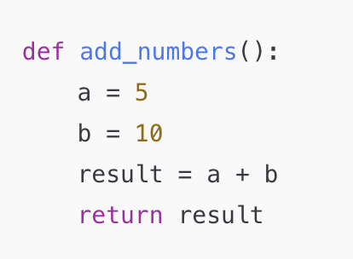
Example 3: PVM
Provide the bytecode generated for the following Python function, compute_product().
Use dis.dis() format, but without the source code line numbers from the first column. Assume Python version 3.10.

Slide 28
How to approach?
1. Break Down Each Line of the Python Function:
Write out each line of the function separately, including assignments, calculations, and the return statement
Label each line with what it does (e.g., “assigns a constant,” “performs addition,” “returns a variable”)
2. List Common Bytecode Instructions and Their Purposes:
Create a small reference guide on the side for common bytecode instructions:
LOAD_CONST: Loads a constant onto the stack
STORE_FAST: Stores a variable
LOAD_FAST: Loads a variable onto the stack
Arithmetic Operations: Use BINARY_ADD for addition, BINARY_SUBTRACT for subtraction, etc
RETURN_VALUE: Returns the value at the top of the stack

Slide 29
How to approach (continued)?
3. Assign Offsets Sequentially:
Start with an offset of 0 for the first instruction and increase by 2 for each subsequent instruction
Write down the offset before each instruction to maintain the flow (e.g., 0, 2, 4, etc.)
4. Translate Each Line to Bytecode:
For each line in the function:
Determine if it’s an assignment, operation, or return
Use the reference list to pick the appropriate bytecode instructions
For example, if a line is a = 5, write down LOAD_CONST followed by STORE_FAST, increasing the offset by 2 for each step
Don’t forget to include any constants or variable names in parentheses after each instruction (e.g., LOAD_CONST 1 (5) or STORE_FAST 0 (a))

Slide 30
How to approach (continued)?
5. Organize the Bytecode:
Write the bytecode in a clear list, each line including the offset, instruction, and arguments if applicable
Leave space between bytecode segments to make it easier to check each section
6. Review for Common Patterns:
Check that you’ve included:
Assignments with LOAD_CONST and STORE_FAST
Arithmetic or Boolean operations with BINARY_ instructions if needed
Loading and returning variables correctly with LOAD_FAST and RETURN_VALUE
Make sure there’s a final RETURN_VALUE instruction if the function has a return statement
7. Double-Check Each Offset and Instruction:
Go through each line to ensure offsets increase correctly, each instruction is appropriate, and all variables/constants are accurately represented in parentheses

Slide 31
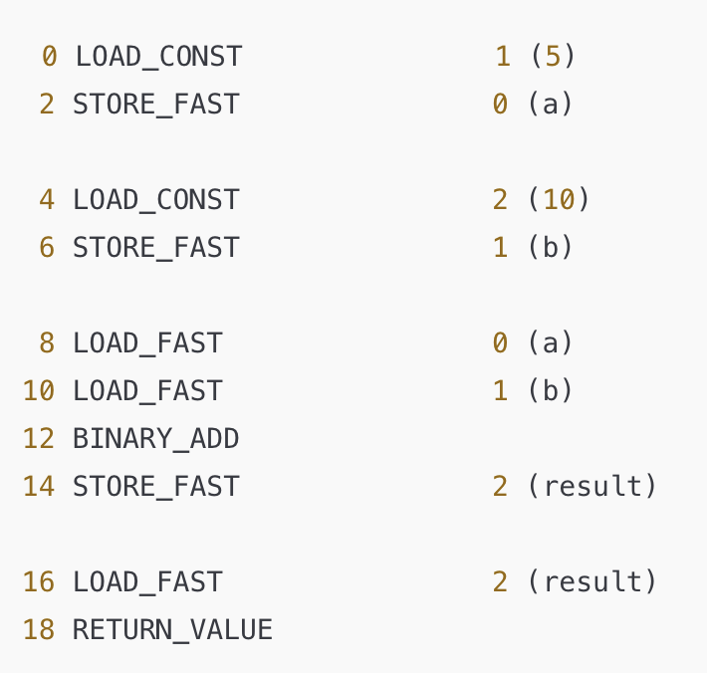
Answer
Here’s how each line of bytecode corresponds to the original function:
Variable Initialization:
a = 5: LOAD_CONST 1 (5) loads the constant 5 onto the stack, and STORE_FAST 0 (a) stores it in the variable a.
b = 10: LOAD_CONST 2 (10) loads the constant 10 onto the stack, and STORE_FAST 1 (b) stores it in the variable b.
Addition Operation:
result = a + b: LOAD_FAST 0 (a) loads a onto the stack, LOAD_FAST 1 (b) loads b onto the stack, and BINARY_ADD adds them together. The result is then stored in result with STORE_FAST 2 (result).
Return Statement:
return result: LOAD_FAST 2 (result) loads result onto the stack, and RETURN_VALUE returns it as the output of the function.

Slide 32
Agenda
Midterm Logistics
Reviewing resources
Unix
Python review
Python Virtual Machine (PVM)
OOP Methods and Basic Data Structures (Stacks, Queues, and Hash Tables)
Exceptions
Iterators
Decorators
Recursion
Final Tips

Slide 33
OOP and Basic Data Structures
1. What is it?
OOP (Object-Oriented Programming) Methods: OOP is a programming paradigm that allows you to model real-world entities as objects. In Python, OOP concepts such as classes, methods, inheritance, and encapsulation enable the creation of modular and reusable code. These OOP methods provide structure, organization, and a way to represent data and behavior together
Basic Data Structures:
Stacks: A stack is a Last-In, First-Out (LIFO) structure, where elements are added and removed from the same end. Operations include push (add) and pop (remove)
Queues: A queue is a First-In, First-Out (FIFO) structure, where elements are added at one end and removed from the other. Operations include enqueue (add) and dequeue (remove)
Hash Tables: A hash table is a data structure that stores key-value pairs, enabling fast data retrieval by mapping keys to values through a hashing function

Slide 34
OOP and Basic Data Structures
2. Why does it matter?
Organization and Modularity: OOP allows for a more structured codebase where data and functions are organized within classes. This modularity makes code easier to maintain, debug, and extend
Efficient Data Handling: Stacks and queues offer efficient ways to manage ordered data, which is essential in applications like backtracking algorithms (for stacks) or scheduling tasks (for queues)
Fast Data Retrieval: Hash tables allow for nearly constant-time complexity (O(1)) for lookups, making them highly efficient for cases where quick access to data is crucial, such as dictionaries, caching, and managing unique identifiers

Slide 35
OOP and Basic Data Structures
3. Where can you expect to see this?
Application Development: You’ll see OOP used in software applications to create models for users, products, transactions, etc. Data structures like stacks and queues are also used to manage tasks, events, or command histories
Web Development and APIs: OOP principles help design classes that encapsulate API functionalities. Hash tables (or dictionaries in Python) are common in storing configuration settings, managing user sessions, or caching responses
Algorithm Design and Data Processing: Stacks, queues, and hash tables are fundamental in algorithm design. For example, stacks are used in depth-first search (DFS) algorithms, while hash tables help manage unique data items

Slide 36
OOP and Basic Data Structures
What is it?
OOP (Object-Oriented Programming) Methods: OOP is a programming paradigm that allows you to model real-world entities as objects. In Python, OOP concepts such as classes, methods, inheritance, and encapsulation enable the creation of modular and reusable code. These OOP methods provide structure, organization, and a way to represent data and behavior together.
Basic Data Structures:
Stacks: A stack is a Last-In, First-Out (LIFO) structure, where elements are added and removed from the same end. Operations include push (add) and pop (remove).
Queues: A queue is a First-In, First-Out (FIFO) structure, where elements are added at one end and removed from the other. Operations include enqueue (add) and dequeue (remove).
Hash Tables: A hash table is a data structure that stores key-value pairs, enabling fast data retrieval by mapping keys to values through a hashing function.

Slide 37
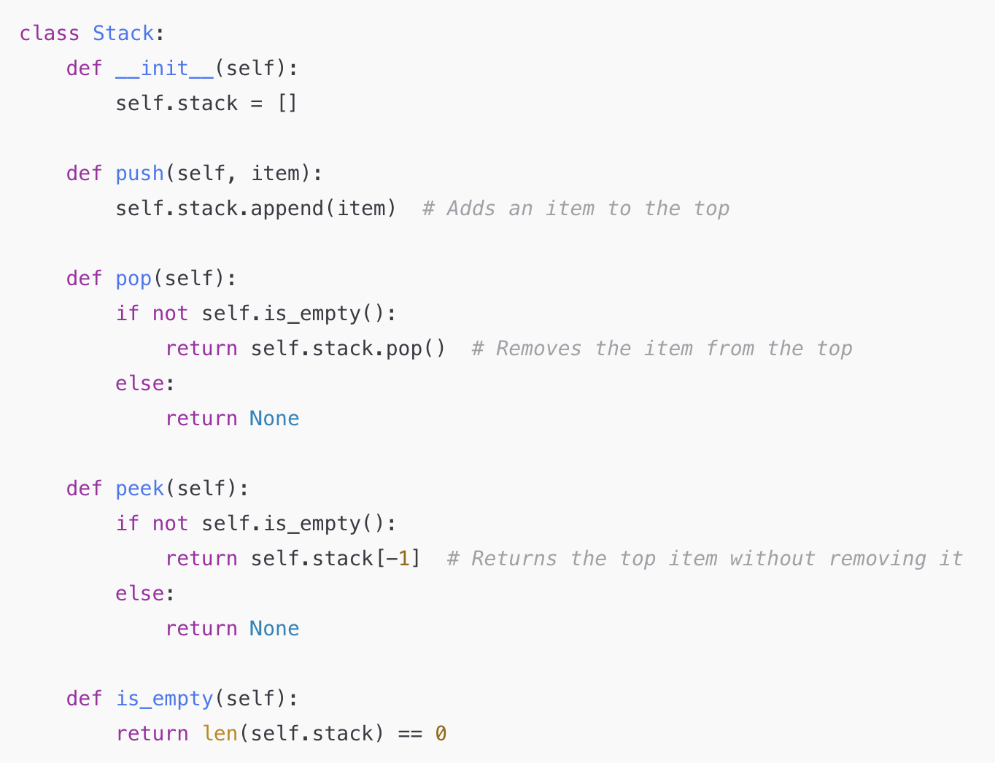
A stack follows the Last-In, First-Out (LIFO) principle. It can be implemented using a list with append (for pushing items) and pop (for removing items)
Use Cases:
Backtracking: Stacks are useful in algorithms that involve exploring all possibilities and then backtracking, such as depth-first search (DFS) in graphs or mazes
Undo/Redo Functionality: Applications like text editors use stacks to keep track of changes, allowing users to undo or redo actions
Expression Parsing: Stacks help evaluate mathematical expressions, especially when handling parentheses or converting infix expressions to postfix
Use append and pop for adding and removing items, respectively.

Slide 38
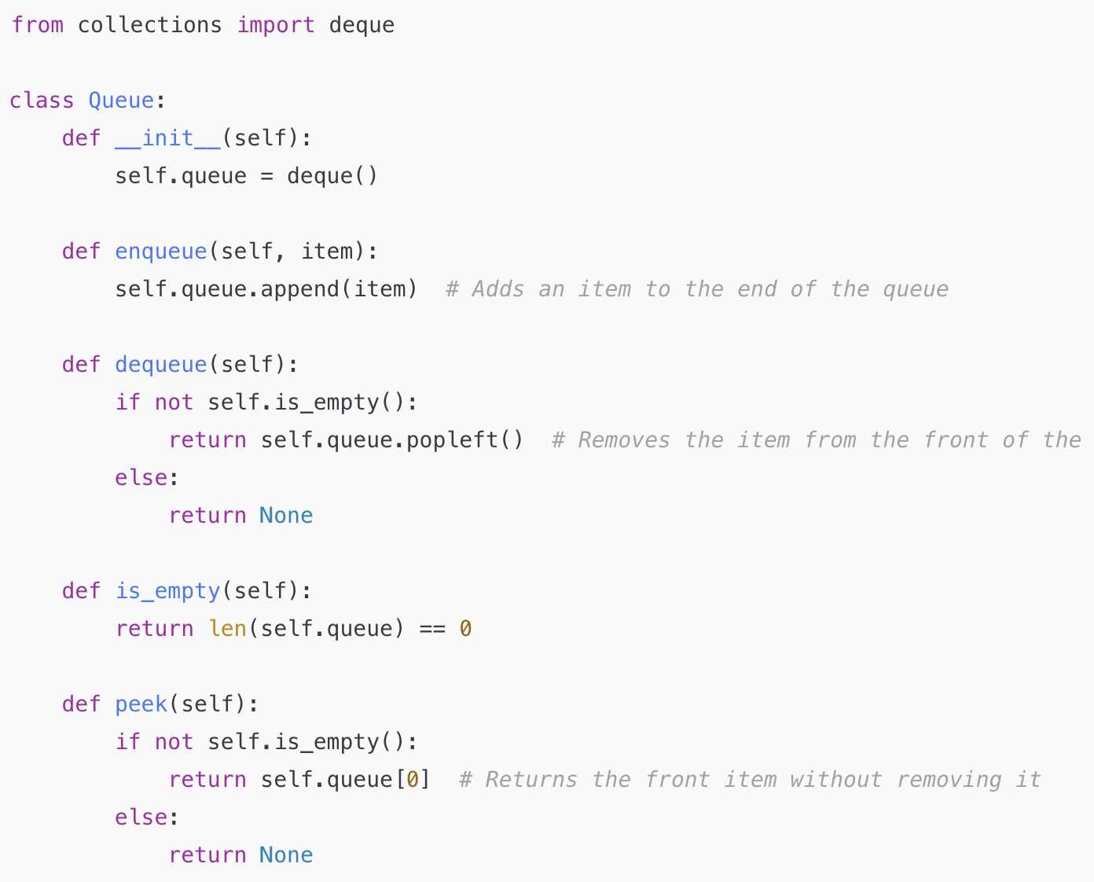
A queue follows the First-In, First-Out (FIFO) principle. It can be implemented using collections.deque for efficient enqueue and dequeue operations.
Use Cases:
Task Scheduling: Queues are used to manage tasks that need to be processed in a specific order, such as jobs waiting to be printed or CPU scheduling in operating systems
Breadth-First Search (BFS): BFS in graphs and trees uses a queue to explore nodes layer by layer
Asynchronous Data Processing: Queues are useful in message-based systems and asynchronous processing, where data is processed in the order it arrives.
Use deque with append for enqueue and popleft for dequeue.

Slide 39
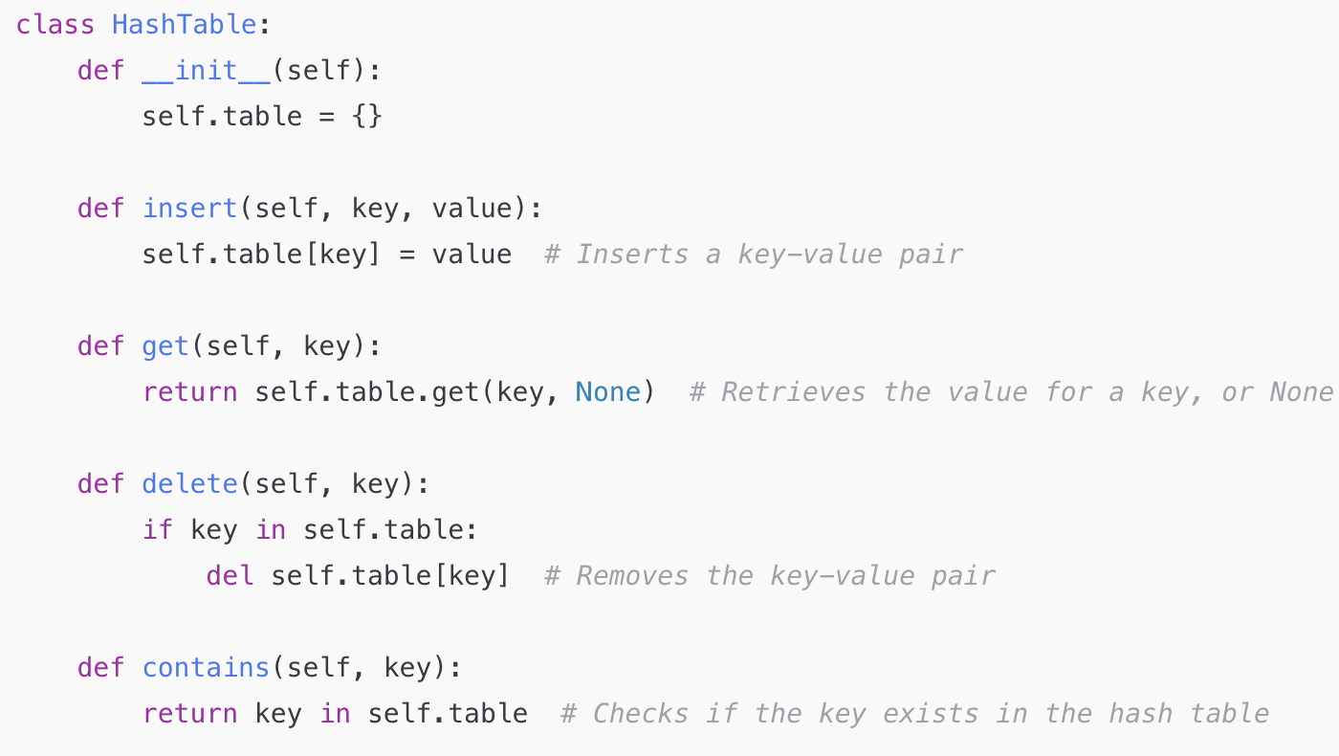
A hash table stores key-value pairs and uses a hash function to map keys to values. In Python, you can use a dictionary to implement a hash table
Use Cases:
Fast Data Retrieval: Hash tables enable fast lookups, making them ideal for implementing dictionaries, caches, and databases
Counting and Frequency Tracking: Hash tables are often used to count occurrences of items, such as words in a document or elements in a dataset
Implementing Sets: Since hash tables store unique keys, they’re often used to implement sets, which require that each element is unique
Use a dictionary to store key-value pairs with insert, get, and delete methods.

Slide 40
Agenda
Midterm Logistics
Reviewing resources
Unix
Python review
Python Virtual Machine (PVM)
OOP Methods and Basic Data Structures (Stacks, Queues, and Hash Tables)
Exceptions
Iterators
Decorators
Recursion
Final Tips

Slide 41
Exceptions
1. What is it?
An exception is an event that disrupts the normal flow of a program. In Python, exceptions are raised when the interpreter encounters an error that prevents it from continuing.
Common exceptions include TypeError, ValueError, IndexError, and FileNotFoundError, among many others
Python provides a way to handle these exceptions gracefully through try, except, else, and finally blocks, allowing developers to manage unexpected events and control program flow even when errors occur

Slide 42
Exceptions
2. Why does it matter?
Robustness and Error Handling: Exceptions are crucial for creating robust programs that can handle errors without crashing unexpectedly. By anticipating possible errors, developers can ensure their code behaves predictably and provide meaningful feedback to the user
Debugging and Troubleshooting: Exceptions make it easier to identify where issues arise in code. Python provides detailed error messages and stack traces that help developers locate the source of the problem, facilitating faster debugging
Maintaining Program Flow: Exception handling allows a program to manage errors while maintaining continuity, rather than terminating abruptly. For example, if an error occurs while reading a file, the program can catch the exception, log the issue, and continue with other tasks

Slide 43
Exceptions
3. Where can you expect to see this?
File I/O: When working with files, exceptions are often raised if a file is missing, inaccessible, or corrupted. For instance, trying to open a non-existent file raises a FileNotFoundError
User Input Validation: Programs that require user input use exceptions to handle invalid inputs. For example, a program might raise a ValueError if a user enters non-numeric data where a number is expected

Slide 44
Exceptions
3. Where can you expect to see this (continued)?
API and Network Requests: When connecting to external servers or APIs, exceptions handle cases like timeouts, connectivity issues, or unexpected responses. This allows the program to retry the connection or gracefully alert the user if the resource is unavailable
Algorithmic and Mathematical Operations: When performing calculations, exceptions can handle scenarios like division by zero (ZeroDivisionError) or out-of-bound index access (IndexError), helping maintain program stability

Slide 45
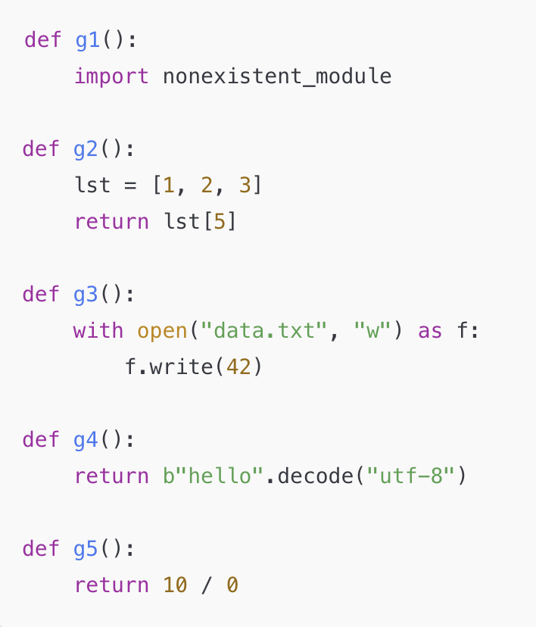
Exception 1 example:
Here, we define several functions, which may or may not raise an exception when executed.
For each function, indicate if an exception is raised always, sometimes, or never.
For always and sometimes, indicate which exception is raised and, for sometimes, specify the conditions under which the exception occurs.

Slide 46
How to approach this?
When approaching this type of exception identification problem, follow these steps:
Read Each Function Carefully: Analyze the code in each function to understand what it’s doing and identify potential issues
Consider Possible Errors: Think about common Python exceptions (e.g., ImportError, IndexError, TypeError) and whether the function might trigger any of them
Determine Exception Frequency:
Decide if the exception will be raised always, sometimes, or never
Always: The exception occurs every time the function is called
Sometimes: The exception depends on external factors or specific conditions
Never: No exception will occur under typical circumstances
Identify the Conditions for "Sometimes": If an exception is raised sometimes, specify the exact conditions under which it occurs (e.g., missing files, invalid module names)
Test Your Understanding: If possible, think through test cases or mentally simulate running the code to check if your predictions make sense
Use Python Documentation: Refer to the documentation for unfamiliar functions or methods to understand their typical behavior and associated exceptions

Slide 47
Answer Key:
g1()
Sometimes: Raises ImportError when nonexistent_module is not found in the Python environment. This happens if the module is not installed
g2()
Always: Raises IndexError because the list lst has only three elements, and accessing index 5 is out of bounds
g3()
Always: Raises TypeError because f.write(42) expects a string argument, but an integer (42) is provided
g4()
Never: The decode("utf-8") method on b"hello" (a valid byte sequence) executes without any issues
g5()
Always: Raises ZeroDivisionError because division by zero is undefined in Python

Slide 48
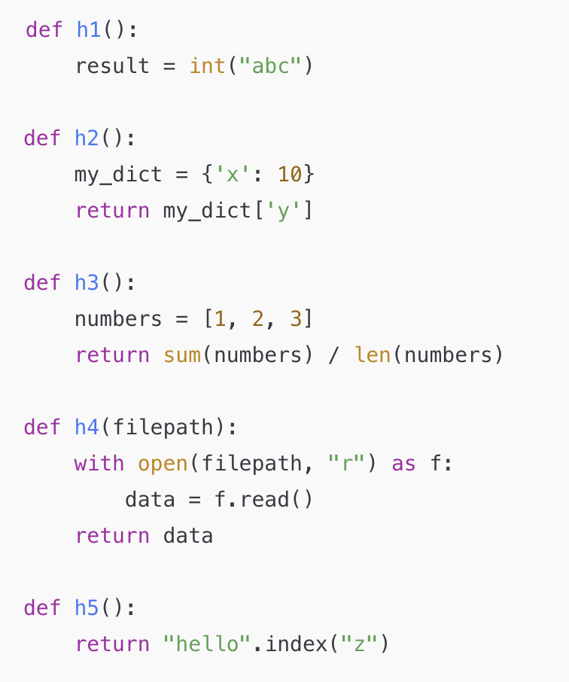
Exception 2 example:
Here, we define several functions, which may or may not raise an exception when executed.
For each function, indicate if an exception is raised always, sometimes, or never.
For always and sometimes, indicate which exception is raised and, for sometimes, specify the conditions under which the exception occurs.

Slide 49
Answer Key:
h1()
Always: Raises ValueError because converting the string "abc" to an integer is invalid
h2()
Always: Raises KeyError because the dictionary my_dict does not contain the key 'y'
h3()
Never: This function calculates the average of a list of numbers, which will work correctly as long as the list is non-empty and contains numeric values. Here, it only has valid numbers, so no exception is raised
h4(filepath)
Sometimes: Raises FileNotFoundError if the specified filepath does not exist or is inaccessible. This depends on whether the file is present and readable
h5()
Always: Raises ValueError because "hello" does not contain the substring "z", so calling index("z") on it fails

Slide 50
Agenda
Midterm Logistics
Reviewing resources
Unix
Python review
Python Virtual Machine (PVM)
OOP Methods and Basic Data Structures (Stacks, Queues, and Hash Tables)
Exceptions
Iterators
Decorators
Recursion
Final Tips

Slide 51
Iterators
1. What is it?
An iterator is an object that allows sequential access to elements in a collection (like a list, tuple, or dictionary) without exposing the underlying data structure
In Python, an iterator is an object that implements the __iter__() and __next__() methods
The __iter__() method returns the iterator object itself, and __next__() returns the next element in the sequence. When there are no more items to return, __next__() raises a StopIteration exception, signaling the end of the iteration

Slide 52
Iterators
2. Why does it matter?
Memory Efficiency: Iterators allow you to work with data collections without loading the entire collection into memory. This is particularly useful for handling large datasets or streams of data, as iterators fetch items one at a time only when needed
Lazy Evaluation: Iterators enable lazy evaluation, meaning values are generated on-the-fly and only computed when accessed. This can greatly improve performance and reduce memory usage for operations on large or infinite sequences
Enhanced Code Readability and Maintainability: Using iterators often leads to cleaner and more readable code. They are foundational for Python’s loop constructs (like for loops), making it easier to write concise and expressive code
Custom Iteration Patterns: Python allows developers to create custom iterator classes, which can be useful for implementing specific traversal or access patterns, such as iterating over data in a custom order or implementing a filter

Slide 53
Iterators
3. Where can you expect to see this?
For Loops: Every time you use a for loop in Python, you’re working with an iterator. Python automatically converts iterables (such as lists, tuples, and dictionaries) into iterators for loop processing
Data Streams and File I/O: Iterators are common in handling data streams and file I/O. For example, using file_object with for line in file_object creates an iterator that reads each line of a file one at a time, conserving memory
Generators: Python's generator functions (using the yield keyword) create iterators. Generators are a convenient way to build iterators without the need to implement __iter__() and __next__() directly, and they’re commonly used for tasks requiring lazy evaluation
Custom Classes: By defining __iter__() and __next__() in a custom class, developers can implement tailored iteration patterns for specific applications, like traversing complex data structures or simulating a sequence of events

Slide 54
Iterators
3. Where can you expect to see this?
For Loops: Every time you use a for loop in Python, you’re working with an iterator. Python automatically converts iterables (such as lists, tuples, and dictionaries) into iterators for loop processing
Data Streams and File I/O: Iterators are common in handling data streams and file I/O. For example, using file_object with for line in file_object creates an iterator that reads each line of a file one at a time, conserving memory
Generators: Python's generator functions (using the yield keyword) create iterators. Generators are a convenient way to build iterators without the need to implement __iter__() and __next__() directly, and they’re commonly used for tasks requiring lazy evaluation
Custom Classes: By defining __iter__() and __next__() in a custom class, developers can implement tailored iteration patterns for specific applications, like traversing complex data structures or simulating a sequence of events

Slide 55
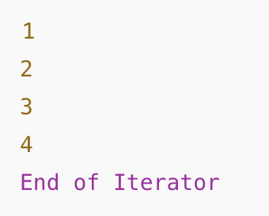
Example
Define a Python function iterator_example() that returns an iterator for a list of numbers [1, 2, 3, 4] and then iterates through it using the next() function
The function should retrieve and return each item in the list one at a time using next()
For each call to next(), if there are no more items, the function should handle the StopIteration exception and return "End of Iterator" instead
Write the function iterator_example() and provide the output of each call to next() on the iterator
Expected output:

Slide 56
How to approach?
To approach this problem, first understand that an iterator allows sequential access to elements in a collection
Begin by creating an iterator from the given list using iter()
Then, use next() to retrieve each element one-by-one
Anticipate the StopIteration exception, which signals the end of the iterator, and handle it with a try-except block to print "End of Iterator" when no more items are available
This structure ensures that all elements are accessed, and the end of the iteration is managed gracefully

Slide 57
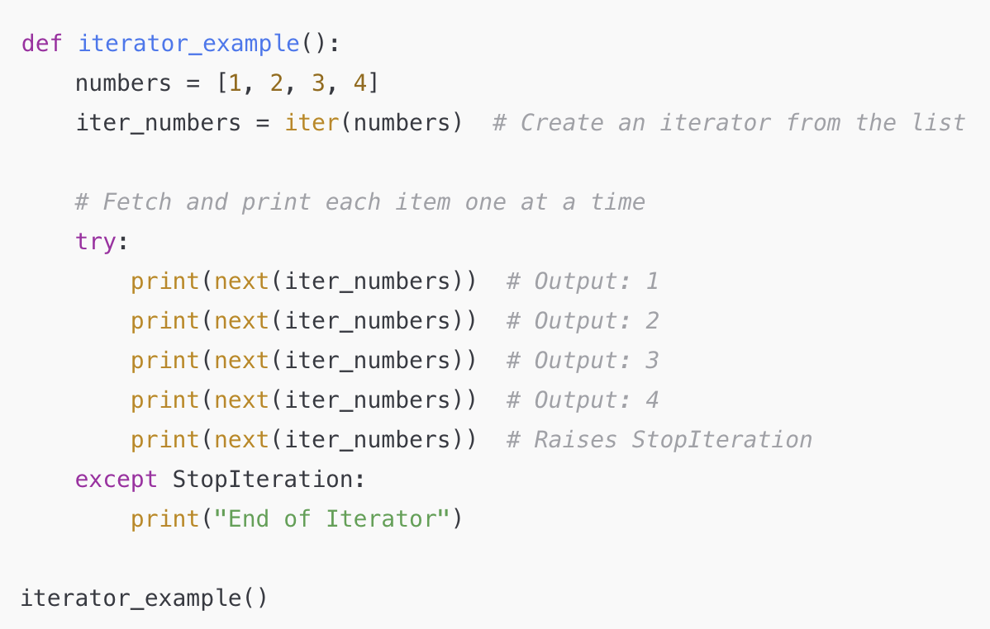
Answer → The function iterator_example() that meets these requirements is:
Iterator Creation:
numbers = [1, 2, 3, 4]: A list is created with four elements
iter_numbers = iter(numbers): The iter() function converts the list into an iterator object, allowing us to traverse the list one item at a time
Using next() to Retrieve Items:
The function uses next(iter_numbers) to retrieve each item from the iterator, moving to the next item with each call
For the first four calls to next(), it returns each item in the list in order: 1, 2, 3, and 4
Handling StopIteration:
After the last item is retrieved, a subsequent call to next() raises a StopIteration exception
The function catches this exception in an except block, printing "End of Iterator" to indicate that there are no more items

Slide 58
Agenda
Midterm Logistics
Reviewing resources
Unix
Python review
Python Virtual Machine (PVM)
OOP Methods and Basic Data Structures (Stacks, Queues, and Hash Tables)
Exceptions
Iterators
Decorators
Recursion
Final Tips

Slide 59
Decorators
1. What is it?
A decorator is a higher-order function that "wraps" another function or method to modify or extend its behavior. In Python, decorators are functions that take another function as an argument, add some functionality, and return a new function or the original function with added behavior
Decorators are applied to functions or methods using the @decorator_name syntax placed above the function definition. This syntax is shorthand for passing the function to the decorator

Slide 60
Decorators
2. Why does it matter?
Code Reusability: Decorators allow you to add functionality to multiple functions without repeating code. This makes code more modular and reusable
Separation of Concerns: By using decorators, you can separate core function logic from auxiliary functionality (like logging, authentication, or caching). This keeps your code clean and focused
Readability and Maintenance: Decorators provide a concise, readable way to add behavior to functions, making the code easier to understand and maintain. For example, adding @log or @authenticate at the top of a function definition clearly indicates the function’s added behavior without cluttering its main logic
Enhanced Functionality: Decorators enable the implementation of cross-cutting concerns like timing, debugging, access control, and more, which are essential for building robust applications

Slide 61
Decorators
3. Where can you expect to see this?
Logging and Debugging: Decorators are often used to add logging to functions, allowing developers to track function calls and outputs. For example, a @log decorator might record when a function is called and what values it returns
Authentication and Authorization: In web applications, decorators are frequently used to control access. For example, an @authenticate decorator could check if a user is logged in before allowing access to a function
Caching and Memoization: Decorators can add caching to functions, storing the results of expensive calculations and returning the cached result on subsequent calls. This is common in performance optimization, where results of certain function calls are saved for reuse

Slide 62
Decorators
3. Where can you expect to see this (continued)?
Timing and Performance Monitoring: A @timer decorator can be used to measure the time a function takes to execute, which is helpful for performance monitoring and optimization.
Class and Method Enhancements: In classes, decorators like @staticmethod, @classmethod, and @property are built-in Python decorators that modify method behavior, such as making a method callable on the class itself rather than an instance.

Slide 63
Example: Decorator implementation
Problem Prompt:
Create a decorator named timed that measures the execution time of a function and prints out the time taken each time the function is called. The decorator should:
Print the function's name, arguments, and the time taken in seconds to complete the call.
Ensure that the decorated function behaves like the original function, preserving its name and docstring.
Then, apply the timed decorator to a function compute_factorial that computes the factorial of a given number n. Test the decorator by calling compute_factorial(5) and compute_factorial(10).
Example Output:
compute_factorial(5) took 0.0001 seconds
compute_factorial(10) took 0.0001 seconds

Slide 64
How could this be approached?
When approaching a problem that involves creating a decorator like timed, here’s a structured approach and the key considerations someone should keep in mind:
Clarify the Decorator’s Purpose: Identify the decorator's function—e.g., timing, logging, caching—and what it should output
Set Up Structure: Create an outer function that takes the original function as an argument, then define an inner wrapper function to add new behavior
Plan Core Logic: Place the necessary logic in the wrapper (e.g., capturing start and end times for timing)
Preserve Metadata: Use @wraps to retain the original function’s name, docstring, and attributes
Implement and Test: Write the code, apply the decorator to a sample function, and test with different inputs
Ensure Transparency: Verify that the decorator doesn’t alter the function’s original behavior or output
Check Reusability: Confirm that the decorator works well with various functions and argument types
Consider Edge Cases: Test scenarios with different input sizes and types to ensure reliability

Slide 65
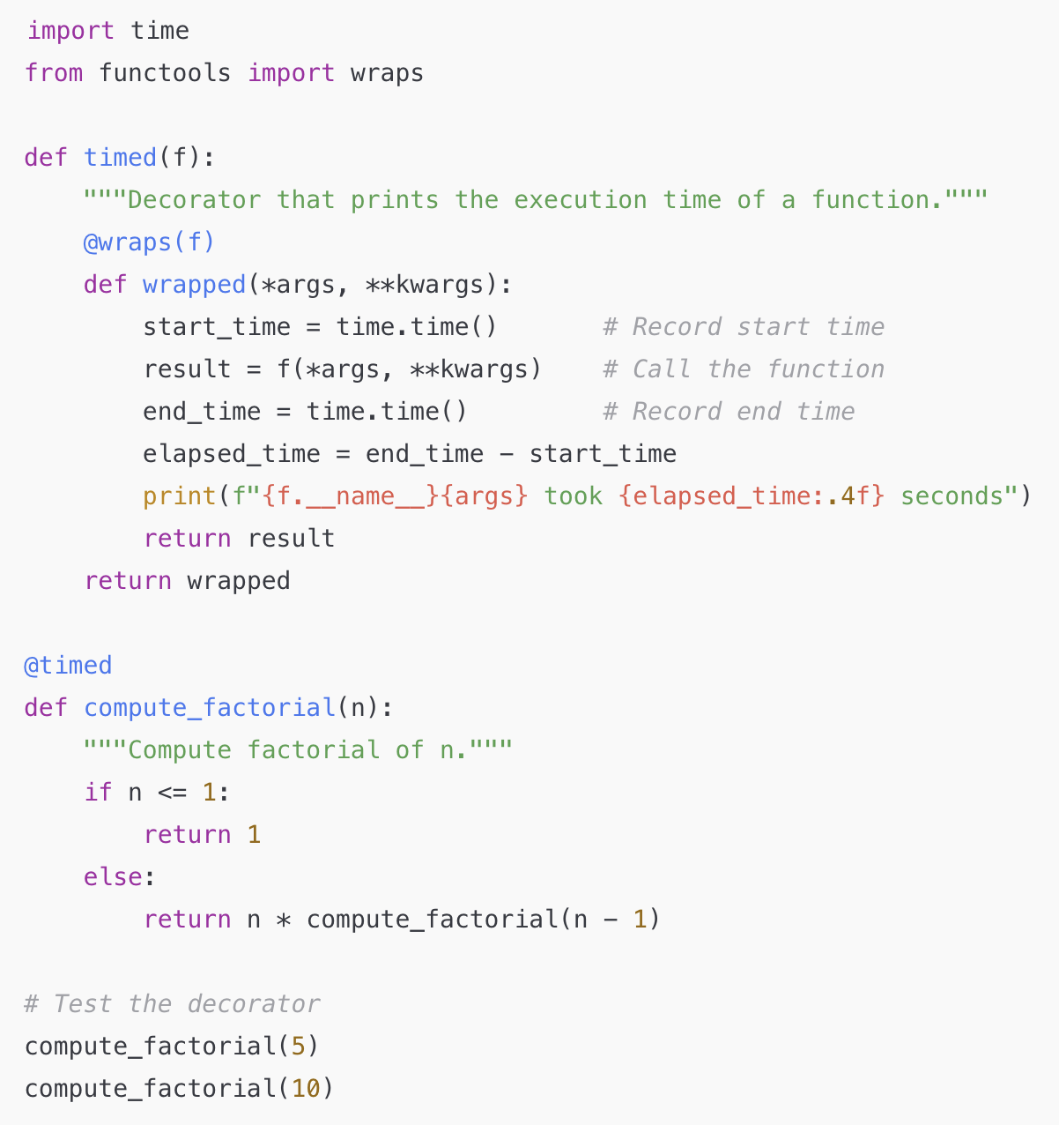
Detailed answer:
The timed decorator calculates and prints the execution time of a function by capturing start and end times with time.time()
It computes the elapsed time and displays it alongside te function's name and arguments
When applied to compute_factorial, the decorator logs the time taken for each call, which is particularly helpful for monitoring performance with recursive functions
Using @wraps(f) ensures the decorated function keeps its original name and docstring, maintaining its metadata

Slide 66
import time: Imports Python’s built-in time module, which provides various time-related functions. Here, we’ll use it to measure the start and end times of the function's execution
from functools import wraps: Imports the wraps function from the functools module. wraps is used in decorators to preserve the original function’s metadata (like its name and docstring) when wrapping it with additional functionality.
def timed(f): Defines the decorator function timed, which takes a single argument f. This argument f represents the function that the decorator will wrap
"""Decorator that prints the execution time of a function.""": This is a docstring describing the purpose of the timed decorator. It explains that timed will print how long a function takes to execute.
@wraps(f): This line is a decorator for the wrapped function inside timed
def wrapped(*args, **kwargs): Defines the inner function wrapped, which takes *args (positional arguments) and **kwargs (keyword arguments)

Slide 67
start_time = time.time(): Captures the current time in seconds since the epoch (a fixed point in time used as a reference)
result = f(*args, **kwargs): Calls the original function f with the provided arguments *args and **kwargs
end_time = time.time(): Captures the current time again, marking the end of the function execution
elapsed_time = end_time - start_time: Calculates the time taken to execute the function f by subtracting start_time from end_time
print(f"{f.__name__}{args} took {elapsed_time:.4f} seconds"): This line formats and prints a message showing the function’s name (f.__name__), its arguments (args), and the time taken to execute (elapsed_time). The :.4f format specifier rounds the elapsed time to four decimal places for readability
return result: We should know what this does
return wrapped: The outer timed function returns the wrapped function, which is now the decorated version of f. When @timed is used on a function, it replaces that function with wrapped, adding the timing functionality

Slide 68
start_time = time.time(): Captures the current time in seconds since the epoch (a fixed point in time used as a reference)
result = f(*args, **kwargs): Calls the original function f with the provided arguments *args and **kwargs
end_time = time.time(): Captures the current time again, marking the end of the function execution
elapsed_time = end_time - start_time: Calculates the time taken to execute the function f by subtracting start_time from end_time
print(f"{f.__name__}{args} took {elapsed_time:.4f} seconds"): This line formats and prints a message showing the function’s name (f.__name__), its arguments (args), and the time taken to execute (elapsed_time). The :.4f format specifier rounds the elapsed time to four decimal places for readability
return result: We should know what this does
return wrapped: The outer timed function returns the wrapped function, which is now the decorated version of f. When @timed is used on a function, it replaces that function with wrapped, adding the timing functionality

Slide 69
@timed: This line applies the timed decorator to compute_factorial. It is equivalent to calling compute_factorial = timed(compute_factorial). From now on, whenever compute_factorial is called, it will run with the timing functionality
def compute_factorial(n): Defines a function to compute the factorial of a given integer n.
"""Compute factorial of n.""": The docstring describes the function’s purpose.
The if and else statements calculate the factorial. If n <= 1, the function returns 1 (base case). Otherwise, it recursively calls itself with n - 1, eventually reaching the base case.
Summary:
The timed decorator measures and prints the execution time of compute_factorial, allowing us to see how long it takes to compute factorials of different numbers. Each component in this code contributes to adding a timing layer around compute_factorial, making it easy to track performance without altering the function's core logic

Slide 70
Agenda
Midterm Logistics
Reviewing resources
Unix
Python review
Python Virtual Machine (PVM)
OOP Methods and Basic Data Structures (Stacks, Queues, and Hash Tables)
Exceptions
Iterators
Decorators
Recursion
Final Tips

Slide 71
Recursion [Same Slides from Last Review]
Recursion is a method of solving problems where a function calls itself as a part of its computation. The key idea is to break a problem down into smaller, more manageable parts until you reach a base case, which stops the recursive calls.
Key Concepts of Recursion
Definition:
Recursion occurs when a function calls itself during its execution.
Base Case:
Every recursive function needs a base case that stops the recursion.
Without a base case, the recursion would go on indefinitely, leading to a "stack overflow" error.
Recursive Case:
The part of the function where the function calls itself with a smaller or simpler input, moving the problem closer to the base case.

Slide 72
Recursion [Same Slides from Last Review]
Why Use Recursion?:
Breaks down complex problems: Recursion is especially useful for problems that can be broken into similar subproblems, such as dividing a list, solving mathematical sequences, or working with tree-like structures.
Elegance and simplicity: Recursive solutions can often be more elegant and easier to read than iterative solutions (loops).
Common Examples:
Factorial calculation: n! = n × (n−1) × (n−2) × ⋯ × 1
Fibonacci sequence: F(n) = F(n−1) + F(n−2)
Navigating nested structures: Recursion is great for navigating trees, directories, and nested lists.

Slide 73
Recursion [Same Slides from Last Review]
Key Steps in Writing Recursive Functions:
Identify the base case:
What is the simplest version of the problem where you know the answer immediately?
Example: For a factorial function, the base case is n == 0, where the result is 1
Identify the recursive case:
How can you break the problem into a smaller version of itself?
Example: For factorials, you can reduce the problem to n * factorial(n-1)
Ensure Progress Toward the Base Case:
Every recursive call should bring the input closer to the base case
If there is no progress toward the base case, the recursion will continue indefinitely

Slide 74
Agenda
Midterm Logistics
Reviewing resources
Unix
Python review
Python Background
Procedure Examples
Regular Expressions
Python Expressions
Recursion
Comprehensions
Object-oriented Programming
Final Tips

Slide 75
Final Tips
Start studying early
Review your last two Psets (especially 4)
Complete the Unix Tutorial, up to Three
Post on Ed Discussions for clarifying answers

Slide 76


