Slide 1
Leadership –
Why it Matters
ERIC B. PROPPER, CFA President
April 27, 2022

Slide 2
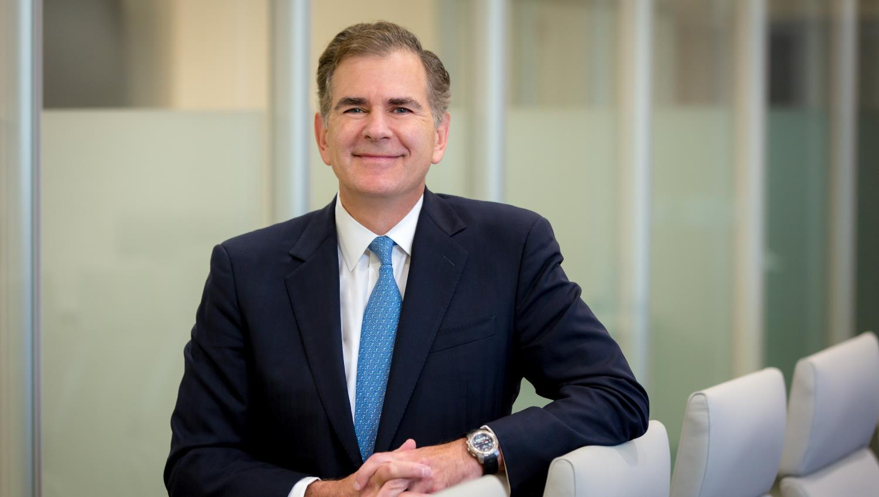
1976-1980
Graduated Choate School/Hobart College
VP Kappa Sigma Fraternity,
Varsity Lacrosse NCAA D3 Champions
1991-1993
Columbia Business School MBA/CFA
1998-2009
NY Office Head/Portfolio Manager
INVESCO/Atlantic Trust/Stein Roe Investment Council
July 29, 1958
Born Meriden/Wallingford, CT
1981-1993
EF Hutton/Shearson
Wealth Manager
1993-1998
J. Bush & Co.
2009-present
President CIBC PWM
Grown AUM from
$7 B to $83 B
Notes:
Over the past 4 decades, in everything I’ve been involved with, I have seen how leadership truly matters in achieving results

Slide 3
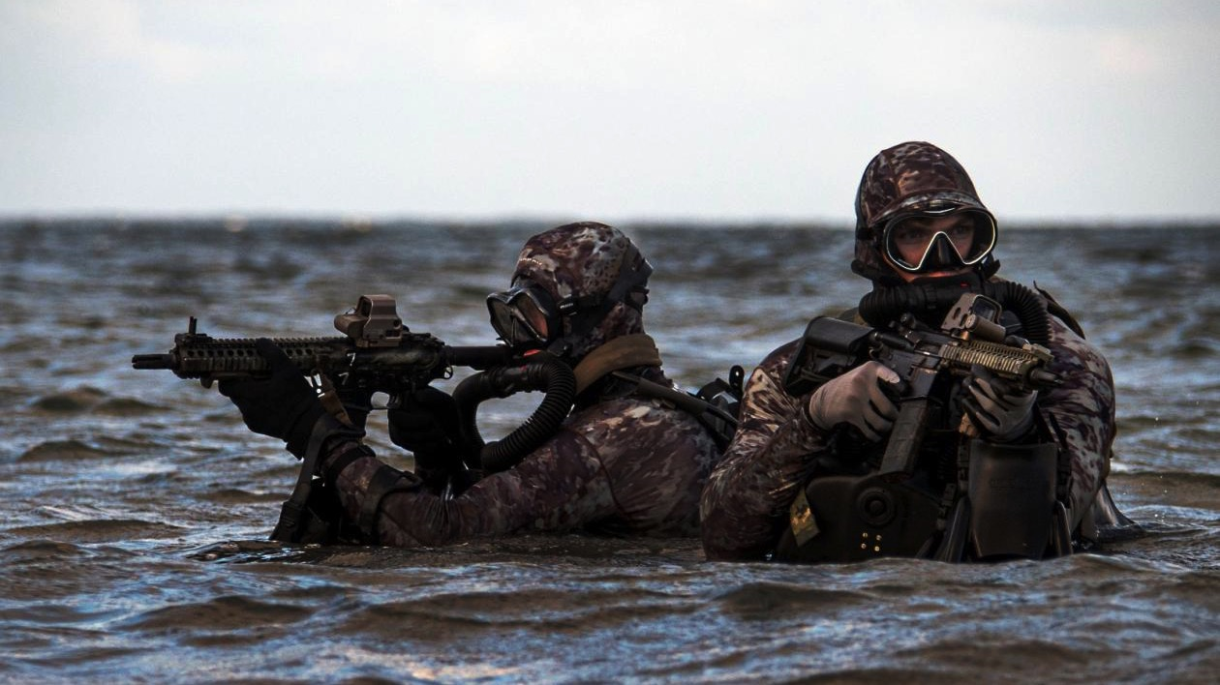
Impact of Leadership: Navy SEALs
Notes:
Navy seal boat comparison video: https://www.youtube.com/watch?v=fmdCz35Ij1k

Slide 4
Notes:
Navy seal boat comparison video: https://www.youtube.com/watch?v=fmdCz35Ij1k

Slide 5
Why Leadership Matters
A recent study of 30,000 corporate leaders found that the top 10 percent of leaders generated twice the corporate net income as the middle 80 percent
Organizations with higher quality leadership have higher employee retention and engagement rates
Share price of organizations with the highest quality leaders are by far more likely to outperform their industry competitors

Slide 6
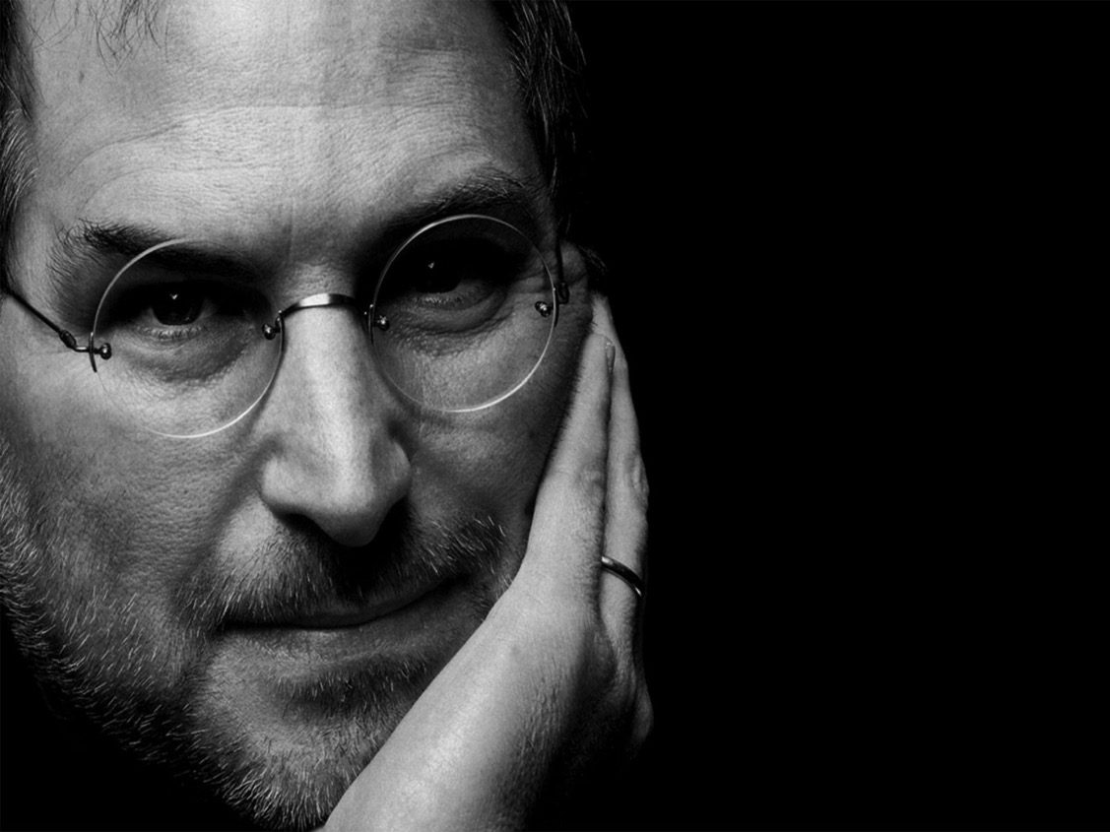
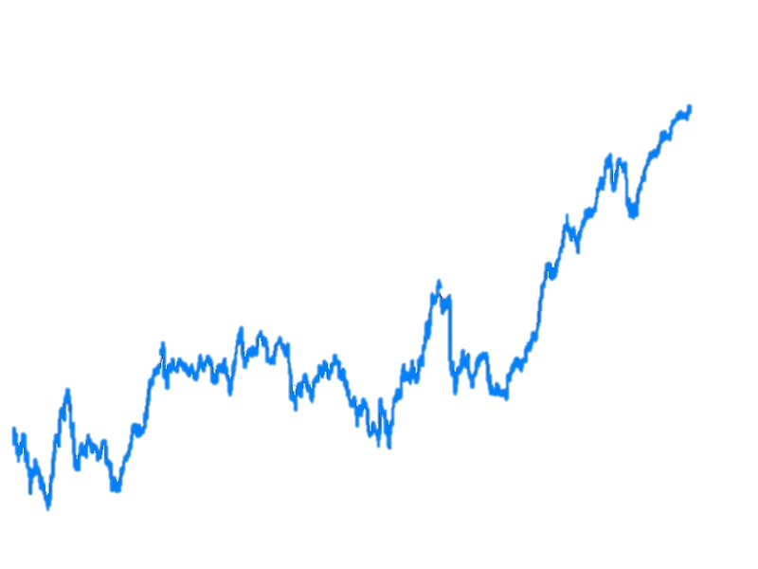
Steve Jobs
Compound Annual Revenue Growth under Jobs’ Leadership (1977-1984): Averaged 248%
Compound Annual Revenue Growth after Jobs forced out (1985-1997): Averaged 11%
Compound Annual Revenue Growth when Jobs returns (1997-2009): Averaged 25%
JOBS RETURNS
JOBS FORCED OUT
APPLE STOCK PRICE 1980-2011
Notes:
Growth Rate
Compound Annual Revenue Growth under Jobs’ Leadership (1977-1984): Averaged 248%
Compound Annual Revenue Growth after Jobs forced out (1985-1997): Averaged 11%
Compound Annual Revenue Growth when Jobs returns (1997-2009): Averaged 25%
Product Introductions
iMac (1998)
iPod (2001)
MacBook Pro (2006)
iPhone (2007)
iPad (2010)

Slide 7
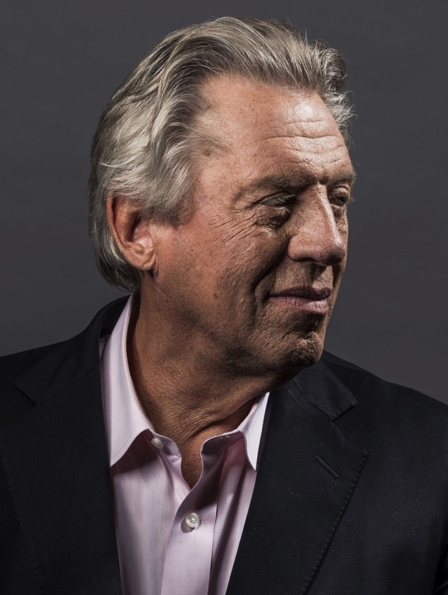
“
A leader is one who knows the way, goes the way,
and shows the way.”
JOHN C. MAXWELL
Leadership Expert

Slide 8
Inspiring leadership in others is the biggest factor in achieving extraordinary results

Slide 9
5 Characteristics of Effective Leaders
Vision
Teamwork
Lead by Example
Integrity
Positive “can do” Attitude

Slide 10
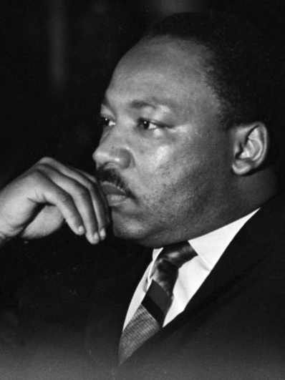
VISION
“
There comes a time when one must take a position that is neither safe nor politically popular, but he must take it because his conscience tells him it is right.”
MARTIN LUTHER KING, JR.
10

Slide 11
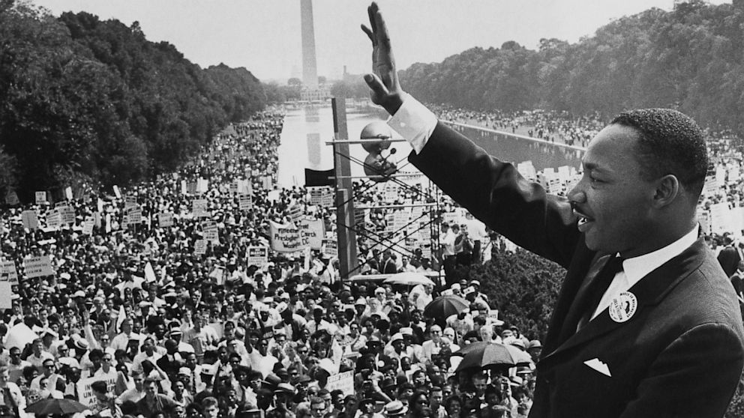
Martin Luther King, Jr. communicated his vision to an audience of over 250,000
people in 1963 at the Lincoln Memorial
Was the youngest person to be awarded the Nobel Peace Prize in 1964
Was also awarded the Presidential Medal of Freedom in 1977, and the Congressional Gold Medal in 2004
21
charter trains carrying Americans from around the country pulled into Washington on the morning of the march
Ultimately led to the passage of the Civil Rights Act of
1964
and Voting Rights Act of
1965
Notes:
In 1999, a group of 137 academics voted the “I Have a Dream” speech the top public address of the 20th century

Slide 12
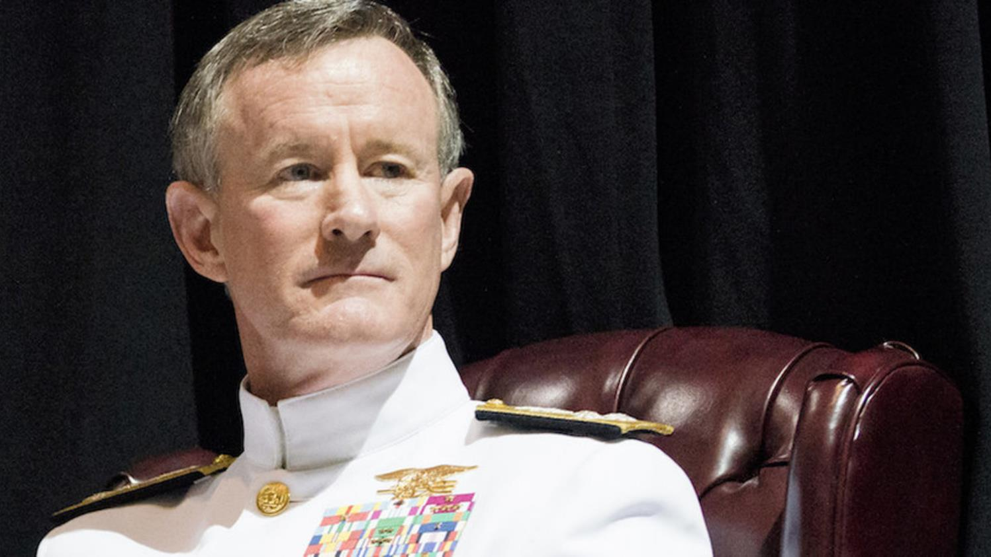
TEAMWORK
Admiral William McRaven
Notes:
Insert Video https://www.youtube.com/watch?v=6ASsZD9xXpY

Slide 13
Notes:
Navy seal boat comparison video: https://www.youtube.com/watch?v=fmdCz35Ij1k

Slide 14
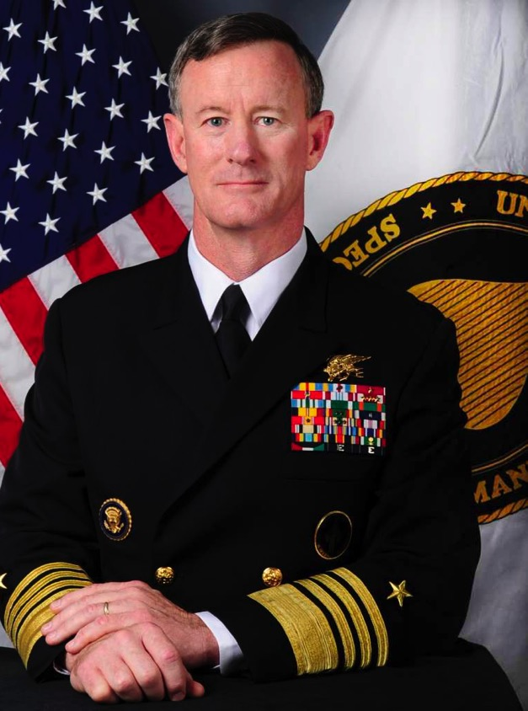
TEAMWORK
Admiral William McRaven
A Proven Record
Served in the Navy for 37 years
Lead the U.S. Special Operations Command from 2011-2014
Commanded the capture of Saddam Hussein
Oversaw the mission responsible for the death of al-Qaeda leader Osama Bin Laden
Served as the chancellor of The University of Texas from 2015-2018

Slide 15
TEAMWORK
“
If you want to change the world, find someone to help you paddle.”
ADMIRAL WILLIAM MCRAVEN

Slide 16
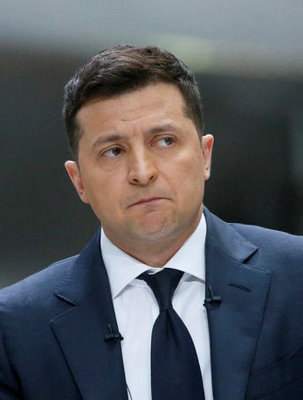
LEAD BY EXAMPLE
“
The fight is here. I need ammunition, not a ride.”
VOLODYMYR ZELENSKY
Notes:
Quote from Bill about Melinda’s impact

Slide 17
LEAD BY EXAMPLE
Volodymyr Zelensky
Accomplishments
Graduated Kyiv National Economic University – Law Degree
Co-founded Studio Kvartal 95 – Ukraine’s most successful entertainment studio
Successful Actor and Comedian
Elected President of Ukraine 2019
Notes:
Cumulative Amount of Charitable Donations: $50.1 billion

Slide 18
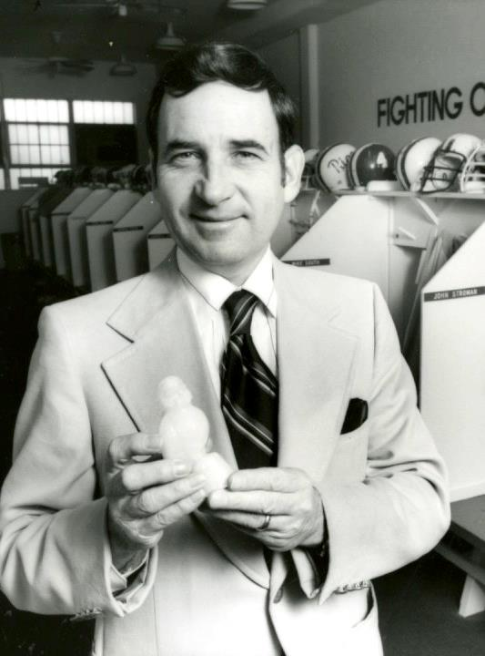
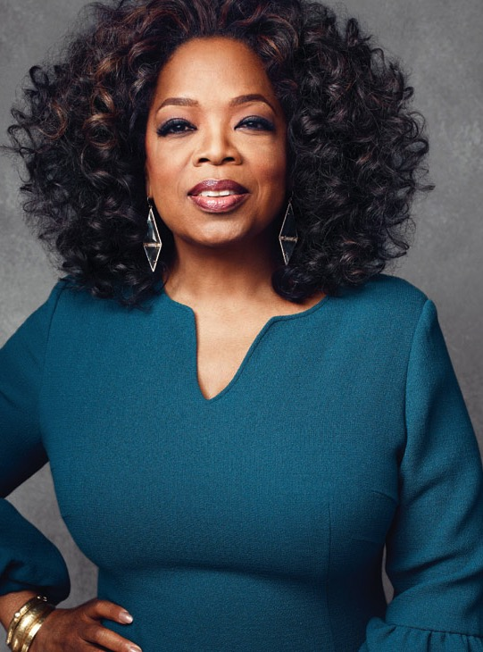
Positive CAN DO Attitude
“
The greatest discovery of all time is that a person can change their future by merely changing their attitude.”
OPRAH WINFREY
18

Slide 19
Positive CAN DO Attitude
Oprah Winfrey
Adversities
Born to an unmarried teenage mother and grew up in rural poverty in Mississippi and inner-city Milwaukee
Winfrey became pregnant at 14, but her son was born prematurely and died shortly after birth
For months, visualized herself as an actress & told everyone she would play ‘Sofia’ in “The Color Purple”
Oprah credits her months of visualization, hoping, and positive thinking for getting that part

Slide 20
Positive CAN DO Attitude
Oprah Winfrey
Accomplishments
Net worth $2.5 billion
Has starred in 23 movies
Started her own talk show and TV network
Wealthiest African American of the 20th century
Ranked the greatest black philanthropist in American history
Notes:
Oprah Winfrey
Born to an unmarried teenage mother who was a housemaid and grew up in rural poverty in Mississippi and inner-city Milwaukee
Winfrey became pregnant at 14, but her son was born prematurely and died shortly after birth
Spent months and months visualizing herself as an actress as a young woman
Told anyone who would listen she was going to play ‘Sofia’ in the movie “The Color Purple”
2 months after her audition, she had heard nothing, and she was convinced it was because she was fat
She then went to a “fat farm”, and while she was simultaneously crying and running laps around the track, she got a call from Steven Spielberg, saying she had gotten the part
Oprah credits her months of visualization, hoping, and positive thinking for getting that part

Slide 21
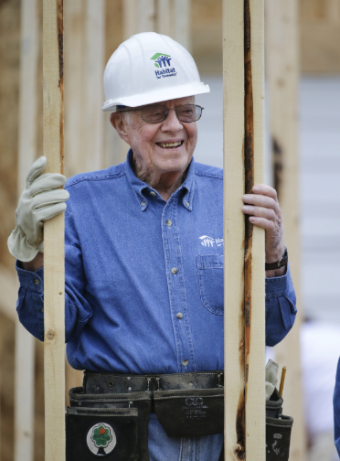
INTEGRITY
“
We must adjust to changing times and still hold to unchanging principles”
JIMMY CARTER

Slide 22
INTEGRITY
Jimmy Carter, 39th U.S. President
Nobel Peace Prize winner
Pioneer for diversity and inclusion
Focused on bettering the lives of people
Established The Carter Center in 1982

Slide 23
Leadership Decision Making – Avoiding Pitfalls
Hubris
Relying on models/data
Not getting other points of view
Zero sum decisions
Compromising values

Slide 24
Leadership Decision Making – Best Practices
Developing a North Star
Developing “consensus”
Avoiding asymmetrical risk
Making Win/Win decisions
Mentors – both old and young
Reading Suggestions
-How to Win Friends and Influence People, Dale Carnegie 1936
-How to Decide, Annie Duke

Slide 25
The call of a leader
is to give their all for
the greater good

