Slide 1
Automated Decision Systems
Guest Lecturer: John Niccolai

Slide 2
Introduction
Introduction
John Niccolai
Chief Operating Officer
Fixed Income & Macro (FI&M)
Career
  Joined Citadel in 2008
    Chief Operating Officer (2019 – Present)
    Head of Portfolio Construction (2018 -2019)
    Head of Quantitative Research (2011 – 2018)
    Quantitative Researcher (2008 – 2011)
      Prior to Citadel was at both JP Morgan & Credit Suisse
  Education
  Ph.D. in Mathematics from Columbia University
  B.S. Mathematics Caltech

Slide 3
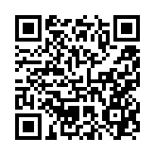
Agenda
Section 1 – About Citadel
  Citadel
  Fixed Income & Macro
Section 2 – Market Overview
  How Does Fixed Income Impact You?
  News overview / Risk Factor overview / Product overview
  Government Spending and the Economy
  FX
  Mortgages
Section 3 – Case Studies
  Evaluating trading counterparties
  Evaluating risk through market simulations
  Monitoring a live portfolio
Section 4 – Roles in the Industry
Section 5 – Q&A
QR Code to connect with our recruiting team:

Slide 4
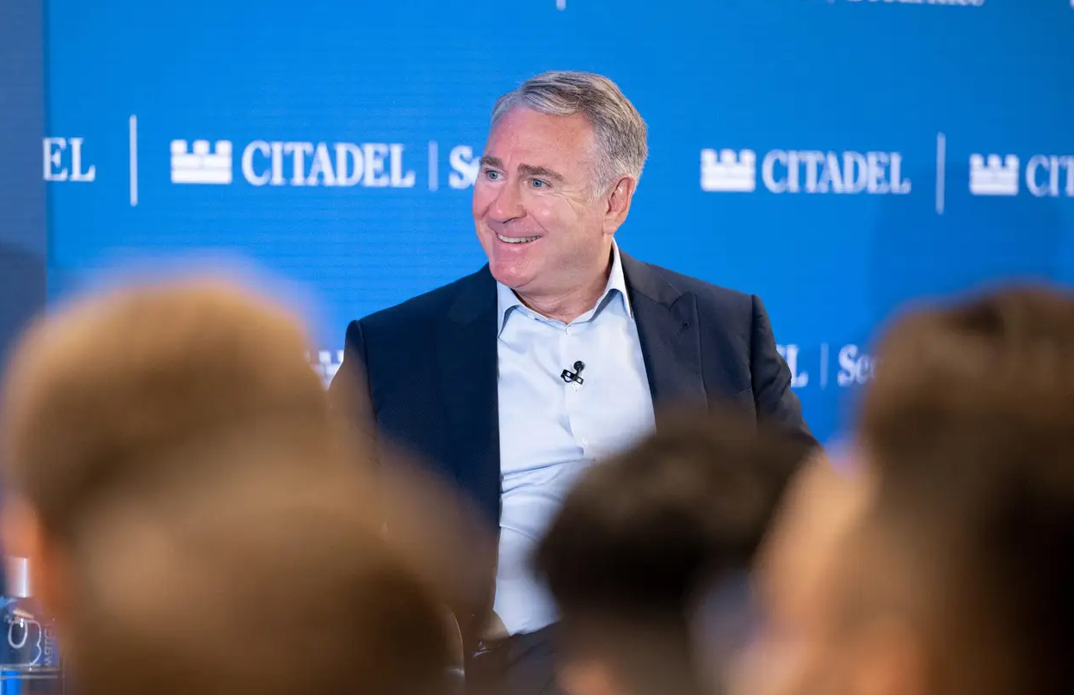
The Most Successful
Investment Team of All Time
We strive to identify the highest and best uses of capital.
We deploy capital to generate superior long-term returns for the world’s preeminent public and private institutions.
We invest in the most promising companies whose innovations improve billions of people’s lives.
Our CEO, Ken Griffin
1990
Founded
$68B
In investment capital as of August 2025
6x
Winner of Multi-strategy Hedge Fund Manager of the Year by Institutional Investor
#1
Most profitable hedge fund manager of all time*
*Edmond de Rothschild estimates, The Top 20 Great Money Managers by Net Gains since inception (after fees) to 31 December 2025. Awarded January 18, 2026.
February 2026

Slide 5
Citadel – Fixed Income & Macro
Our Fixed Income and Macro strategy seeks to generate alpha in fundamentally driven investments as well as relative value investments.
Business Head
Edwin Lin
Employs a combination of macroeconomic research and analysis, quantitative modeling, and a rigorous investment process to identify and capture opportunities.
Focuses primarily on investments in the global fixed income and foreign exchange markets.
Invests in a broad range of investment instruments including sovereign debt, currencies and currency forwards, futures, interest rate swaps, equity indices, options, and other derivatives.
Fast Facts:
Formed in 2008 – by middle of that year, we had ~12 people
Several original members are still on the team
Over the years, we have expanded from trading rates to mortgages, emerging markets, foreign exchange, and more.
Locations
New York, Greenwich, Miami London, Paris and Dubai
Team
210+ Investment Professionals
Macro
Relative Value
Volatility
The macro strategy generally seeks to identify Investment Instruments that are mispriced relative to a range of anticipated economic outcomes.
The relative value strategy generally seeks to minimize direct first order macro-economic exposures, focusing on investing in combinations and/or groups of related Investment Instruments which the Portfolio Manager identifies as being mispriced relative to each other.
The volatility strategy generally seeks to profit from relative value opportunities in interest rate and FX options using rigorous quantitative analytics and sophisticated risk management techniques.

Slide 6
Market Overview

Slide 7
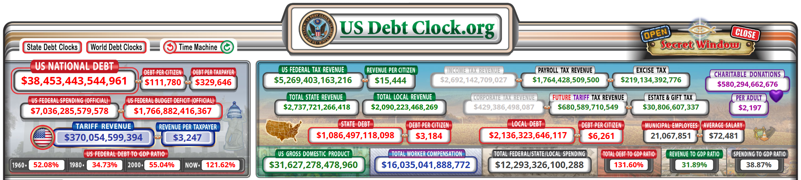
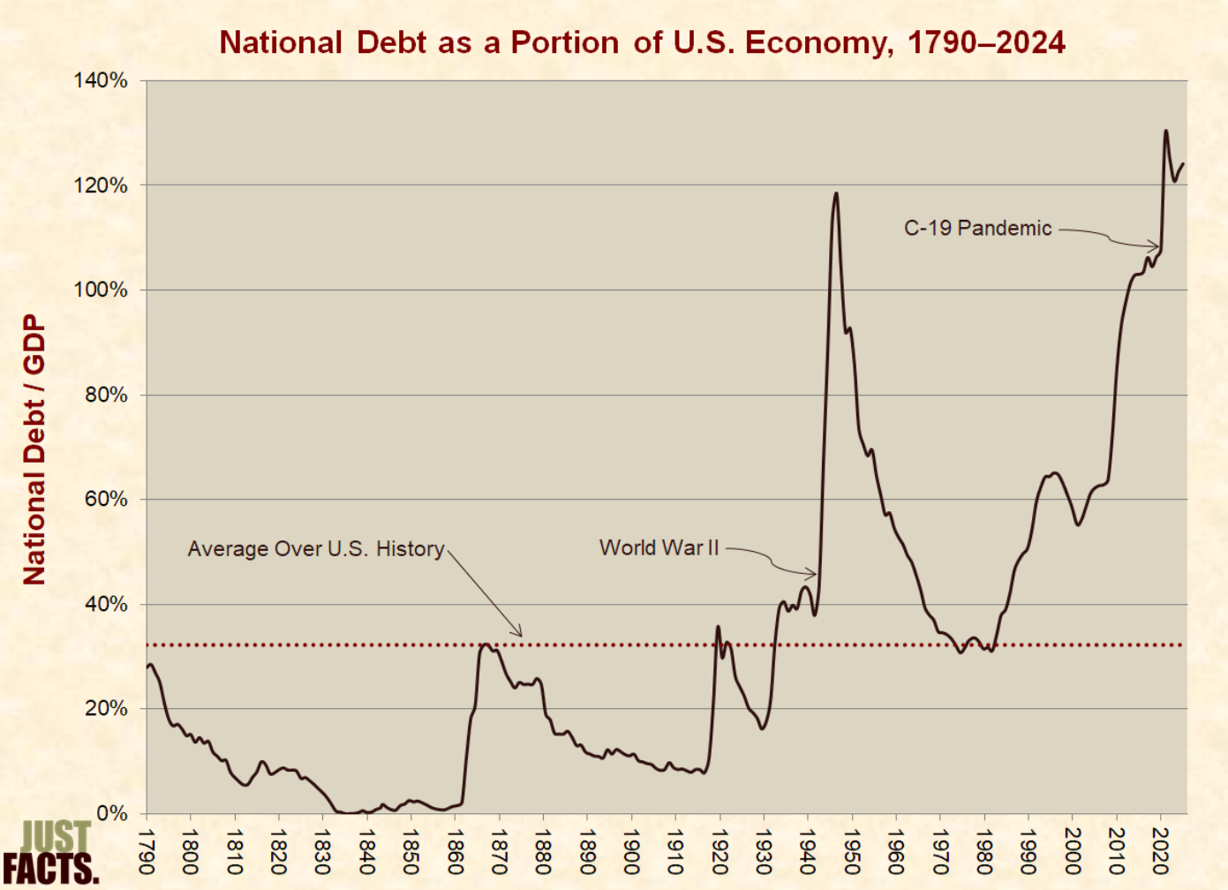
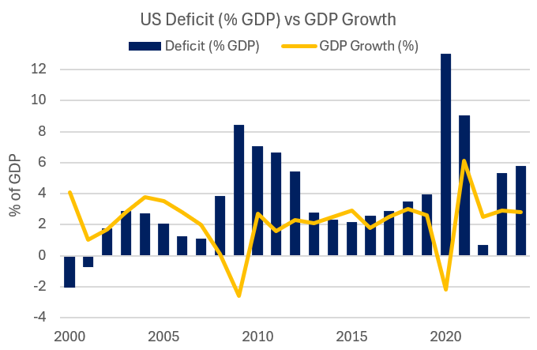
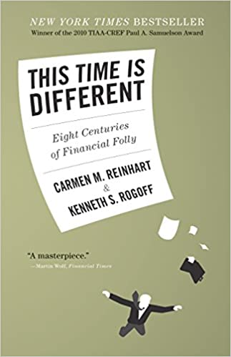
How Does Fixed Income Impact You?
Budget Deficits
Monetary & Fiscal Policy
Inflation Pressures
Some economists believe that things go sideways once the national debt vs GDP ratio hits 130%...

Slide 8

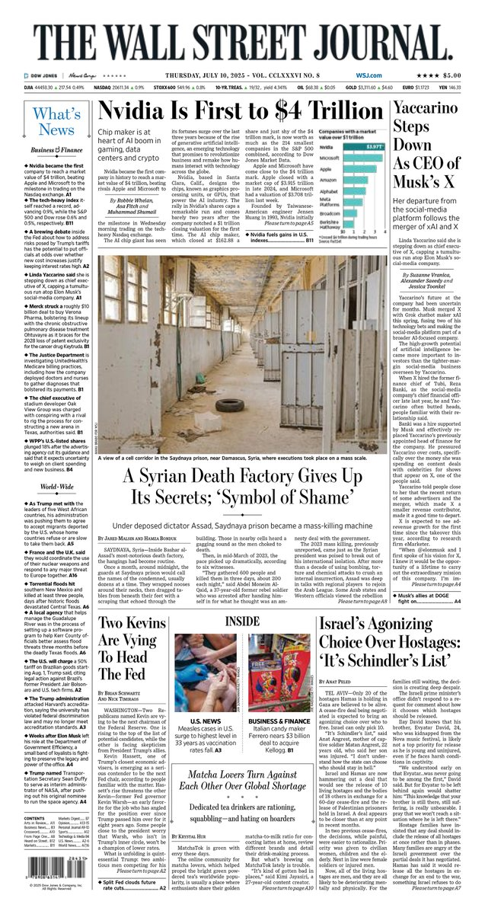
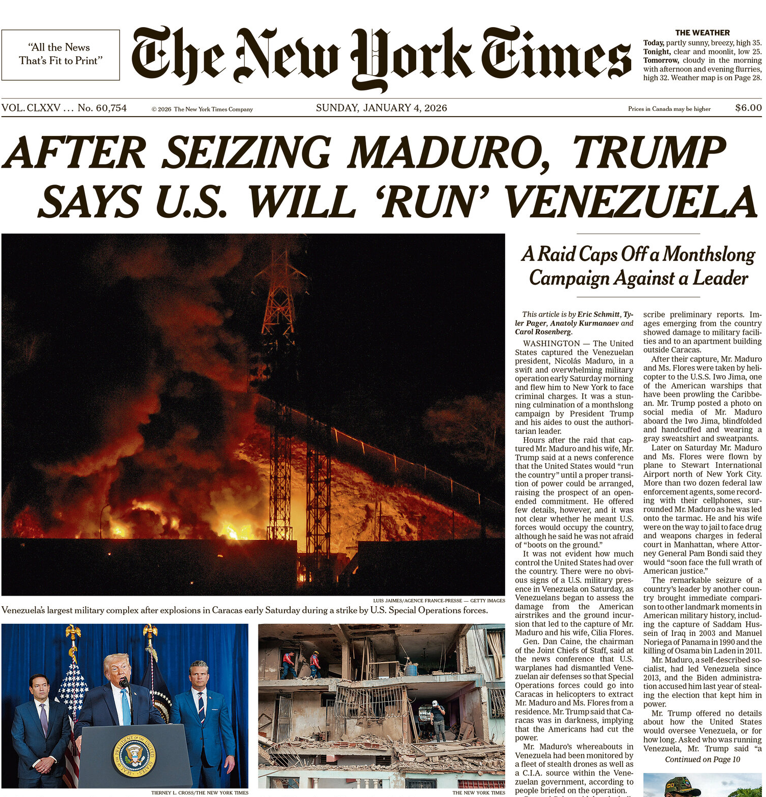
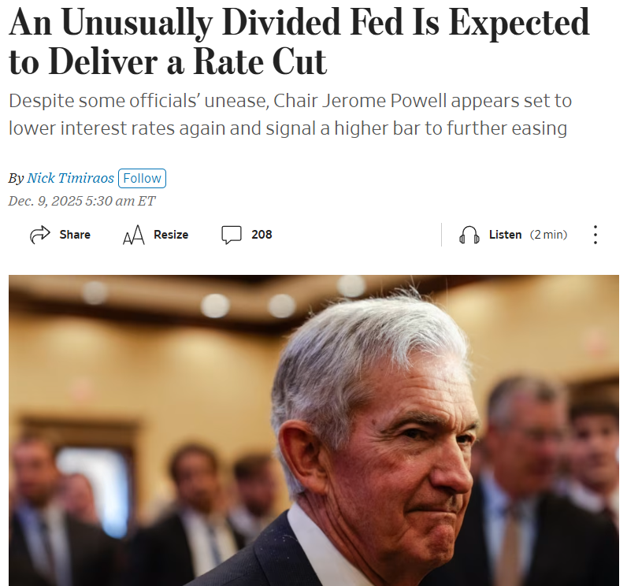
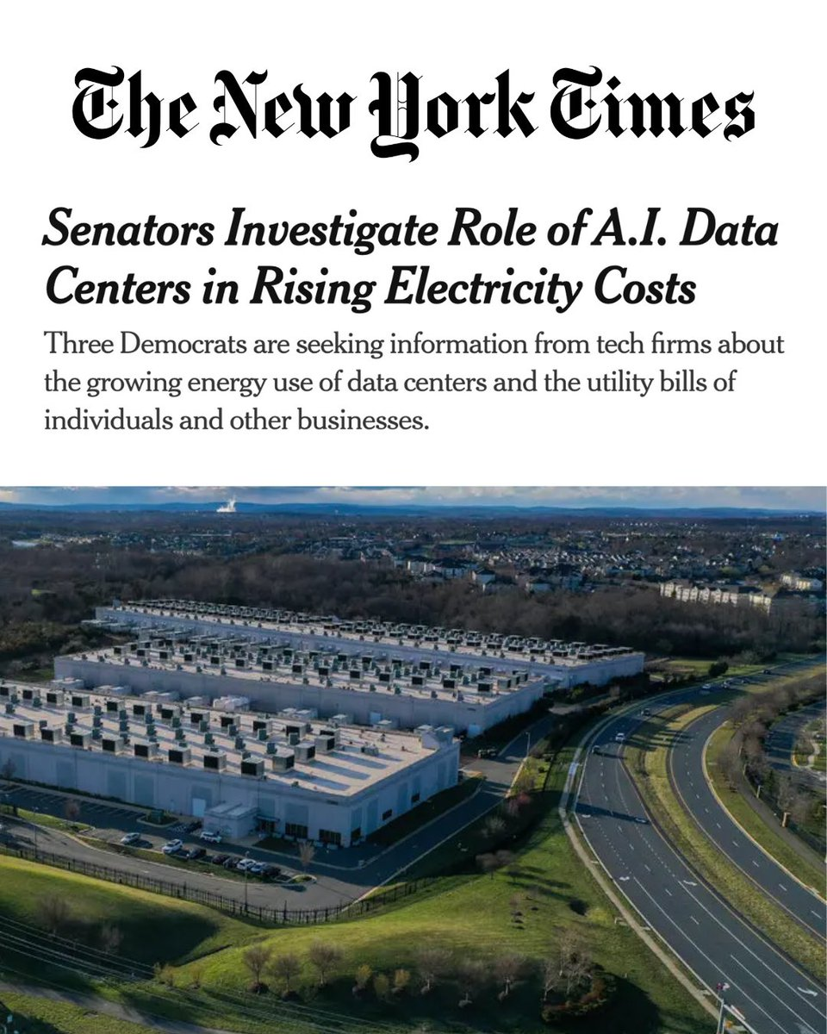
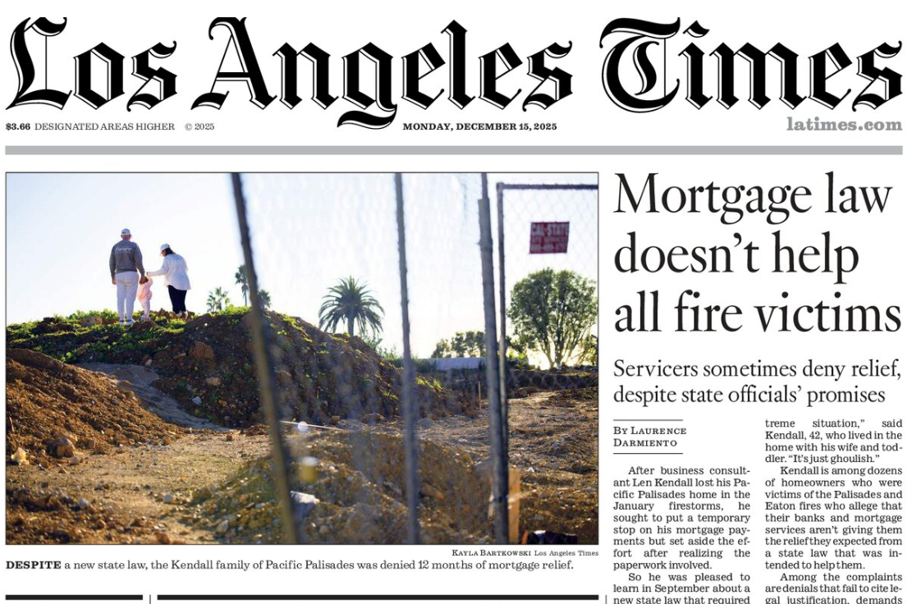

News Overview

Slide 9

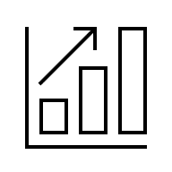

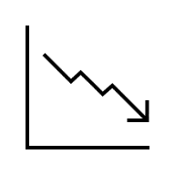

Risk Factor Overview
What are the risk factors we look at in Fixed Income and Macro?
Rates
  Growth Expectations
  Central Bank policy (front-end)
  Liquidity Conditions
  Flow Dynamics
  Fiscal Outlook
  Term Premium Repricing
FX
  Interest-rate Expectations
  Policy Divergence
  De-Dollarization
  Fiscal Stability
  Geopolitics
Equity
  Global Risk Appetite
  Earnings, Margins
  Investor Positioning
  Regulation
  AI
Inflation
  Growth + Credibility of Policy Responses
  Supply-Demand Imbalances (Goods, Labor, Energy)
  Housing
  Tariffs
Commodity
  Supply Constraints
  Geopolitical Risk
  Global Demand
  Transport
  Weather

Slide 10





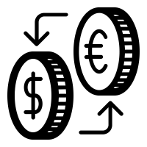


Product Overview: What products let us trade these risk factors?
The categories below broadly describe what a liquid fixed income and macro fund will trade
Listed Products
Currencies
Over The Counter (OTC)
Securities
Options available across
all these categories
Listed on public exchange on limit order book (CLOB)
Trade mechanics: Participants submit bids/offers electronically to the order book, where matching follows price-time priority
Value of one currency in terms of another
Trade mechanics: Executed mainly on electronic Over-the-Counter (OTC) platforms or via bank dealers providing streaming quotes
Bilateral contract between two counterparties
Lacks the level of transparency of listed products
Trade mechanics: Terms negotiated with dealers or via electronic requests for quotes (RFQs), then confirmed and cleared
Issued by an entity e.g. a government
Has a unique identifier (CUSIP)
Wide range of liquidity profiles
Listed
Futures & Options
Equity Indices
OTC
Options
  ~ 30 unique currencies
Cross Currency
Bonds
Inflation
Swaps
Mortgages
  ~110 vol currency pairs
  ~110 vol currency pairs

Slide 11
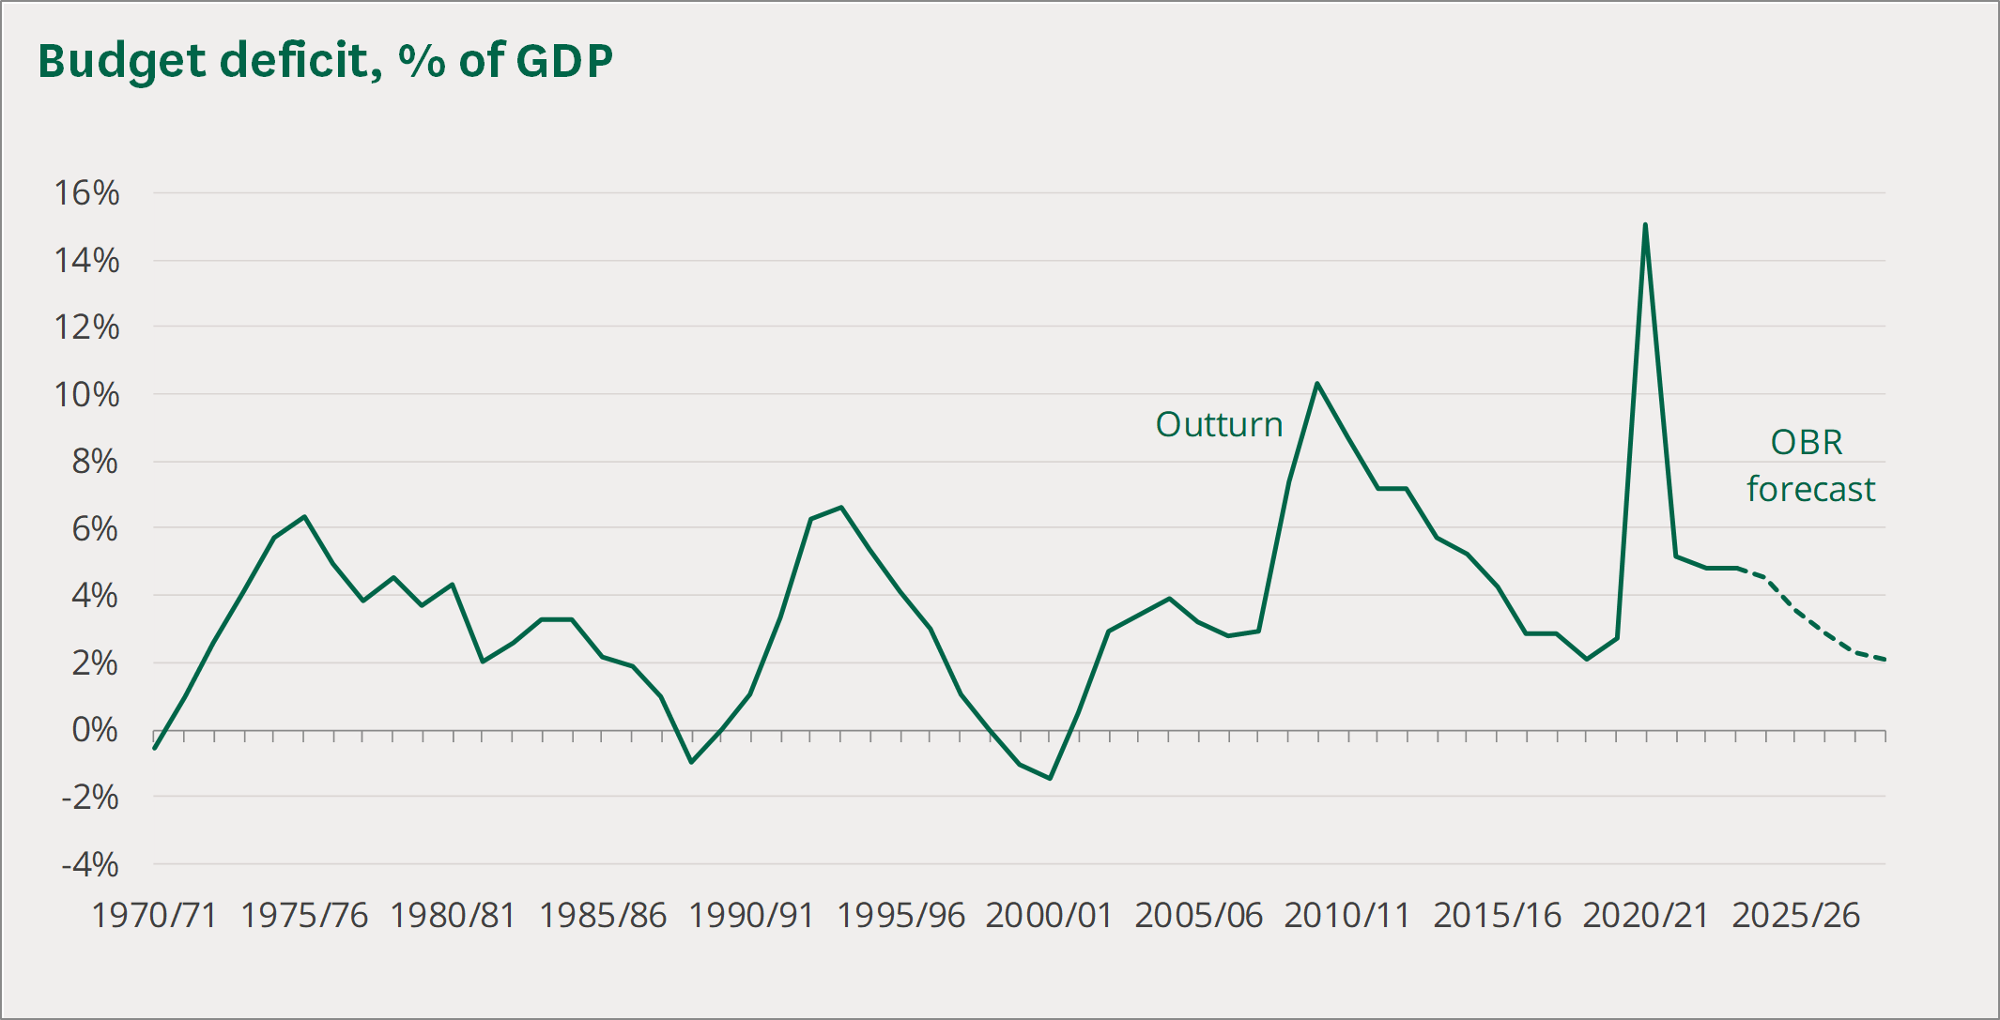
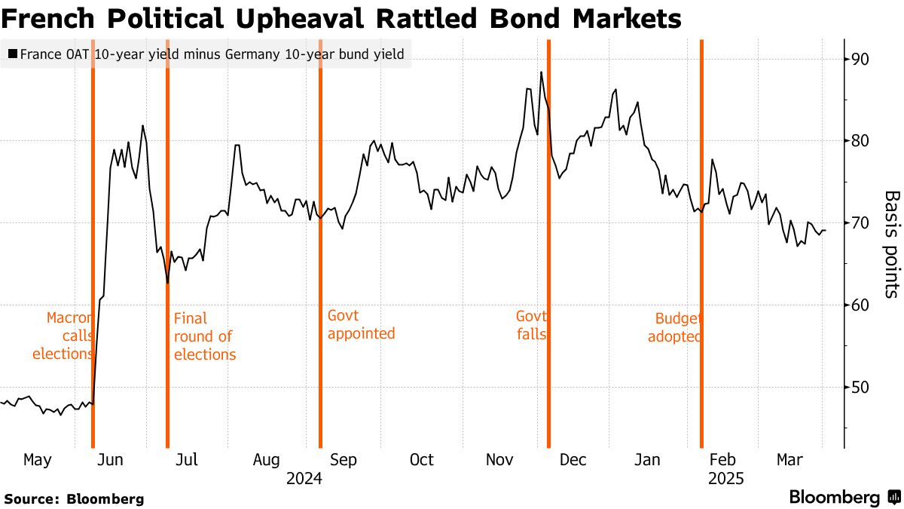
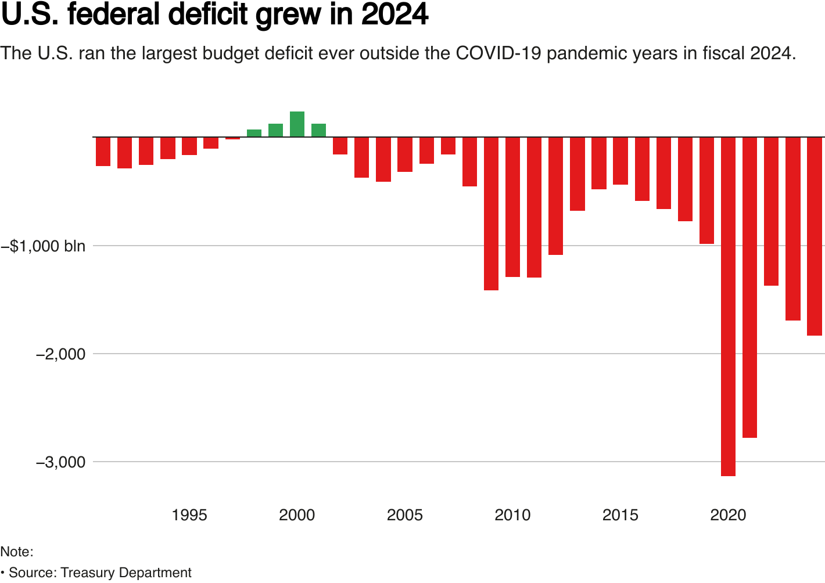
Market Overview – Government Spending & the Economy
The UK, France & the US – Political complications
The UK
Budget Deficit: ~5 %
Debt/GDP: ~95-97 %
Recently in the news: “UK budget beat lacks a long-term lift”
France
Budget Deficit: ~5-6 %, well above EU targets
Debt/GDP: ~114-118 %
Recently in the news: “65-year-old retirees in France now have higher incomes than working-age adults”
The US
Budget Deficit: ~6 %
Debt/GDP: ~100 % and rising
Recently in the news: “The trust funds for Social Security and Medicaid will run out of money in as little as 8 years”

Slide 12
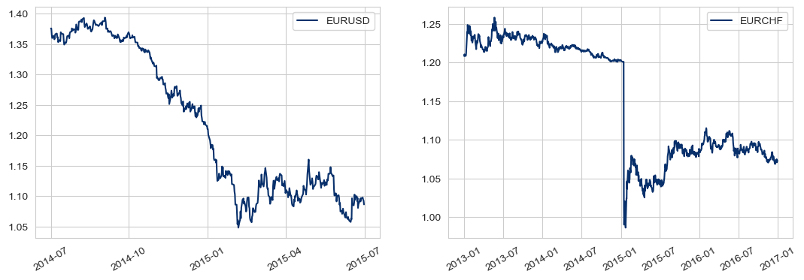
Market Overview – FX in Developed Markets
Generally, developed market currency pairs are expected to be relatively stable (not expected to be move more than 1-2% in a day), reflecting deep liquidity and well-anchored monetary frameworks
However, in 2015, the Swiss franc rallied ~30% relative to the euro after the Swiss National Bank removed its currency peg against the euro
This marked one of the largest DM FX shocks on record and a reminder that policy regime changes can overwhelm normal market dynamics

Slide 13
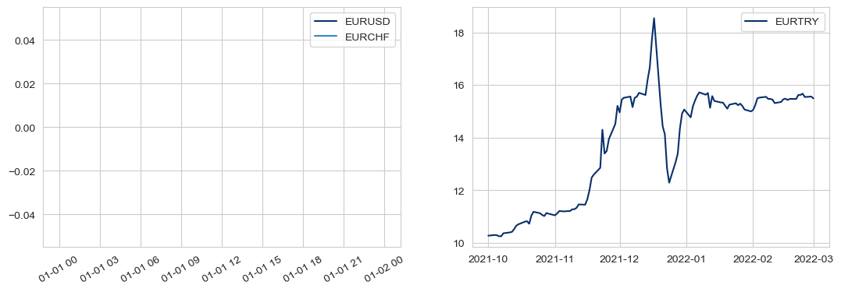
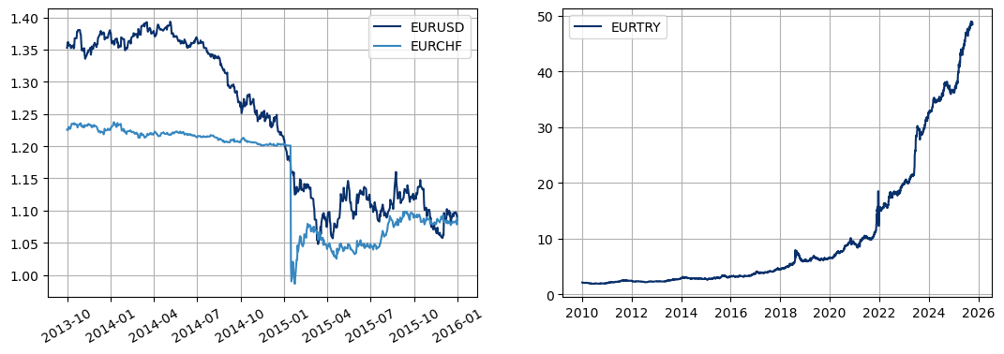
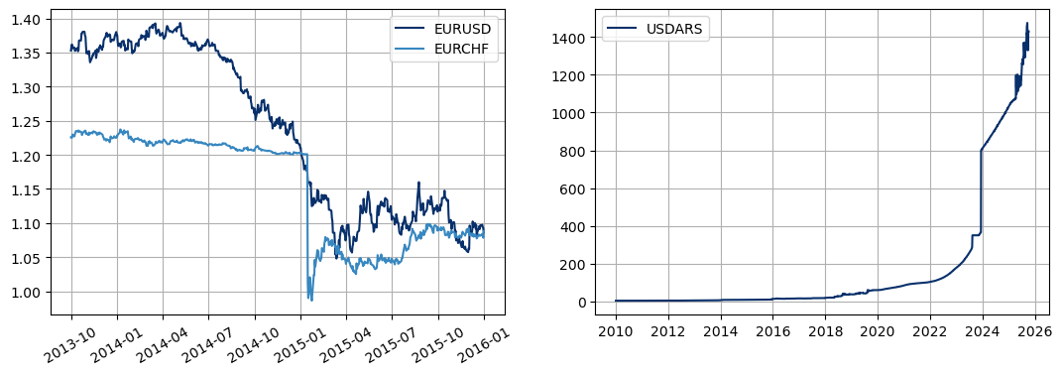
Market Overview – FX in Emerging Markets
In contrast to developed markets, emerging market currencies are structurally more volatile, reflecting:
    Thinner liquidity
    Higher inflation
    Weaker policy anchors
Over the past decade, currencies such as the Turkish lira (TRY) and Argentine peso (ARS) have seen sustained depreciation driven by macro imbalances and policy intervention

Slide 14
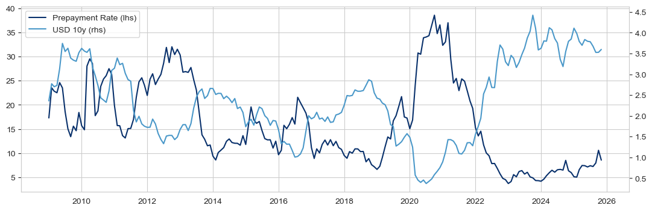
Market Overview – Mortgages
US homebuyers have shown a desire for security with a consistent payment, so banks issue a fixed rate mortgage
  When interest rates fall, mortgage borrowers can refinance at a lower rate or pay off larger parts of their mortgage
  When interest rates rise, mortgage borrowers are disincentivized to refinance/prepay
  Notice the homeowner has an embedded option

Slide 15
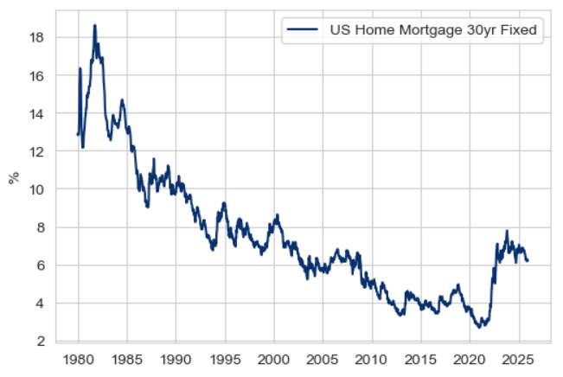
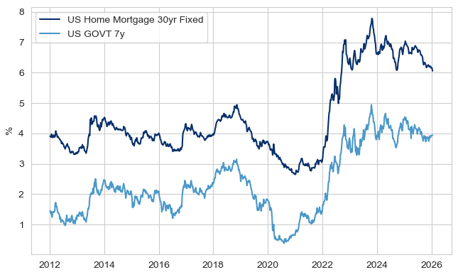
Market Overview – Mortgages
How do Mortgage Rates
Influence Monthly Payments?
Outstanding Mortgages
in the US
Median US Home Price**: $415,200
3% interest rate: $1,400
6% interest rate: $1,991
15% interest rate: $4,200
85 million ($13.1 trillion)
(as of Q2 2025)
Mortgage Rates 1980 - 2025
Mortgage Rates 2012 - 2025
*Source: LendingTree
**Source: BankRate

Slide 16
Market Overview – Mortgages
Bank issues fixed-rate mortgages, but fund their liabilities at floating rates
Recall the homeowner has acquired an option on interest rates embedded in their mortgage loan
  This leads the bank to leveraging the swaption market to hedge this complex exposure
Funds with floating payments
IRS
Homeowner
Bank
Pays fixed
Swap Dealer
Receives fixed payments
Receives floating
Swaption
Homeowner
Bank
Secondary Market
Gives interest rate option
Buys interest rate option

Slide 17
Case Studies

Slide 18



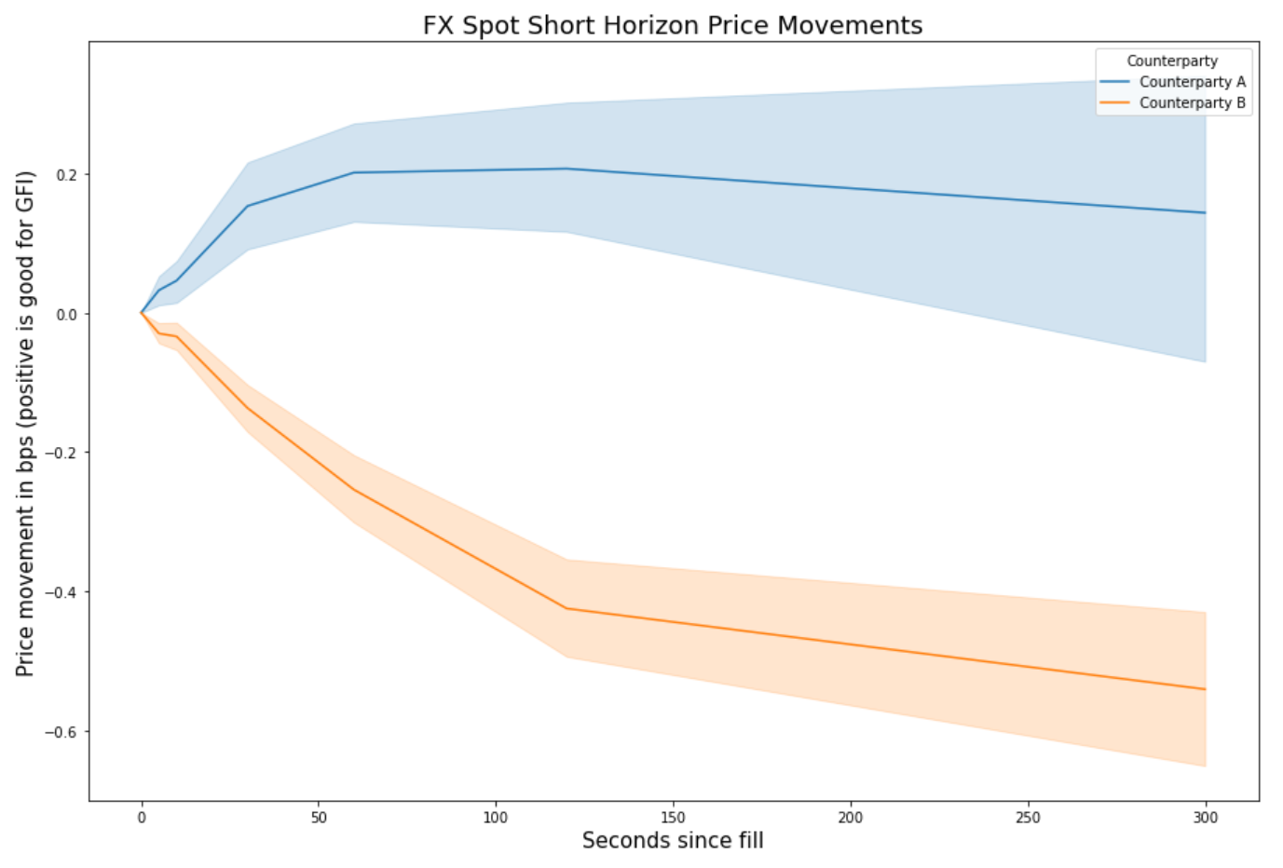

Evaluating Trading Counterparties
Pricing the Trade?
How Many Counterparties?
Who generally has the best price or the tightest/most consistent pricing?
How does the price change after executing with each counterparty?
Resources – What resources do they extend?
Transaction Cost – How much does it cost to do the trade?
Market Impact - How does the price of the trade change post execution?
More counterparties increases likelihood of finding the lowest price but increases information leakage
Counterparties may change their pricing based on how many dealers they are in competition with
We trade in a dynamic environment – Dealers may respond aggressively when losing market share
Case Study #1
Evaluating Trading Counterparties
Case Study #1
Evaluating Trading Counterparties
Case Study #2
Evaluating risk through market simulations
Case Study #2
Evaluating risk through market simulations
Case Study #3
Monitoring a Live Portfolio

Slide 19
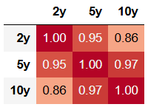
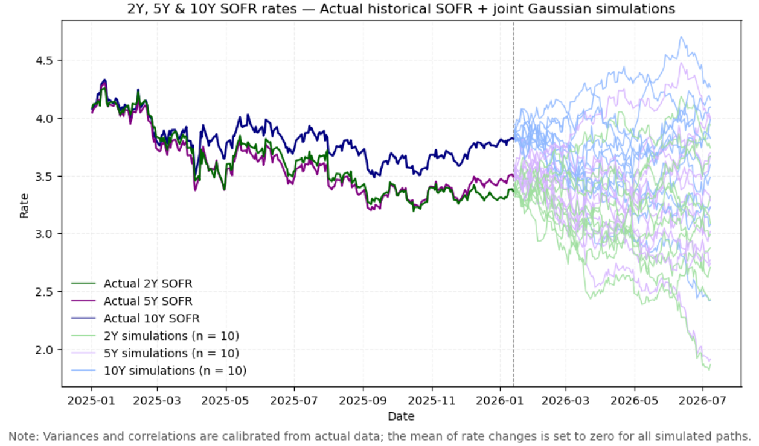
Evaluating risk through market simulations
Common Baseline: Gaussian market simulations
  Variances and correlations estimated from historical data
  Variance scales linearly with time
  Simple, intuitive, computationally efficient
  Dependence captured via constant correlation matrix
  → What could go wrong?
Case Study #1
Evaluating Trading Counterparties
Case Study #1
Evaluating Trading Counterparties
Case Study #2
Evaluating risk through market simulations
Case Study #2
Evaluating risk through market simulations
Case Study #3
Monitoring a Live Portfolio

Slide 20
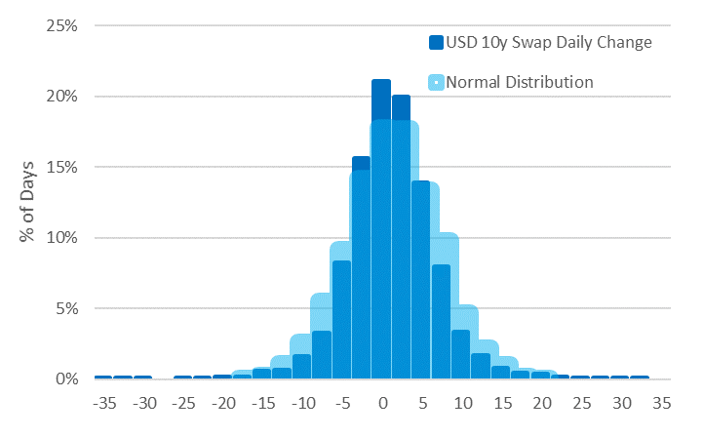
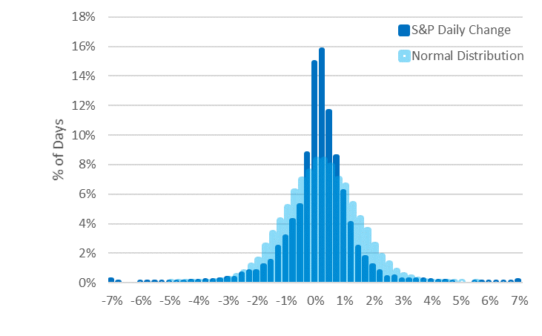
Evaluating risk through market simulations
Tails and skew — Real markets are not Gaussian
  Empirical distributions exhibit:
    Fat tails: more extreme moves than normal
    Skew: asymmetric upside vs downside risk
Case Study #1
Evaluating Trading Counterparties
Case Study #1
Evaluating Trading Counterparties
  Example 1: USD 10Y swap absolute daily moves plotted with a normal distribution with the same mean and standard deviation (-0.06 bps and std 5.6 bps)
Case Study #2
Evaluating risk through market simulations
Case Study #2
Evaluating risk through market simulations
Case Study #3
Monitoring a Live Portfolio
  Example 2: S&P relative daily moves plotted next to a normal distribution with the same mean and standard deviation (mean 0.03 pp and std 1.22 pp)

Slide 21
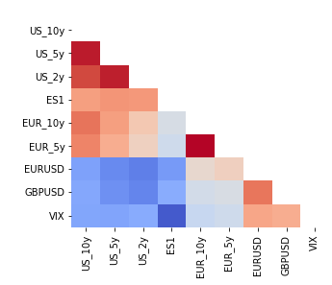
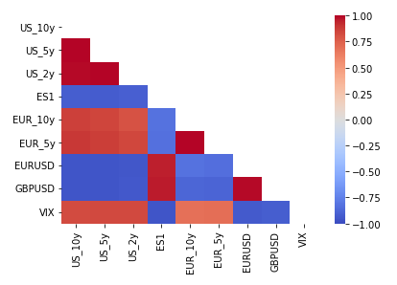
Evaluating risk through market simulations
Correlation is unstable
  Linear correlation captures average co-movement but misses tail dependence
  Correlations are:
    Time-varying / Regime-dependent
    Typically higher in stress: Risk concentrates when assets fail together
Case Study #1
Evaluating Trading Counterparties
Case Study #1
Evaluating Trading Counterparties
Case Study #2
Evaluating risk through market simulations
2018
2023
Case Study #2
Evaluating risk through market simulations
Case Study #3
Monitoring a Live Portfolio

Slide 22
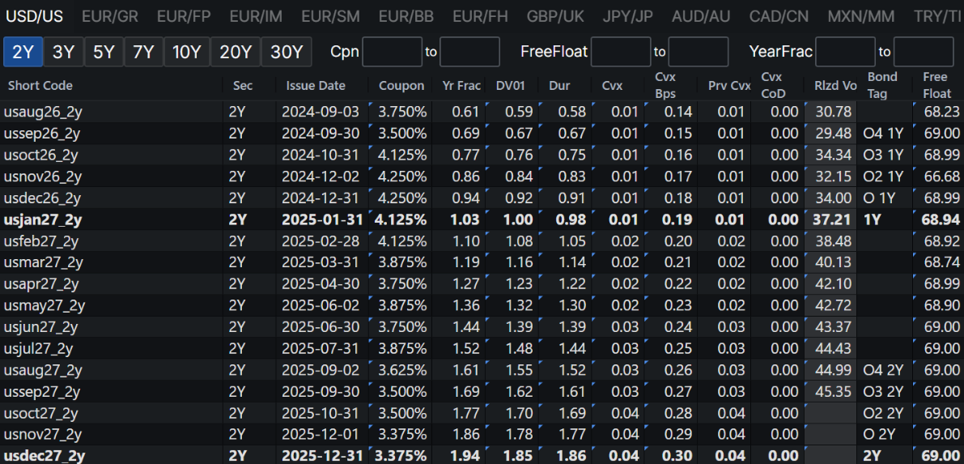
Evaluating risk through market simulations
What needs to be calculated
  Want at least 18 years of market data (through the 2008 Global Financial Crisis)
  Trade all major stock indices
  Trade yield curves in over 20 countries
  Trade bond curves in over 20 countries
  With 45 currencies, possibility to trade 45 choose 2 (=990!) currency pairs
  10,000+ listed SOFR future options, of which 1,600+ are actively traded
  Thousands of listed sovereign bonds
  Portfolio may have tens of thousands of trades
  Requires memory-efficient data structures, a lot of compute, parallelization…
Case Study #1
Evaluating Trading Counterparties
Case Study #1
Evaluating Trading Counterparties
Case Study #2
Evaluating risk through market simulations
Case Study #2
Evaluating risk through market simulations
Case Study #3
Monitoring a Live Portfolio

Slide 23
Monitoring a Live Portfolio
Case Study #1
 | New York Evening | Asia Morning | London Morning | New York Morning
USD Futures
Interest Rate Swaps
Bonds
GBP
FX
Evaluating Trading Counterparties
Trade 23 hours per day (Down from 5-6PM EST)
Case Study #2
Evaluating risk through market simulations
Trade 22 hours per day (Thin liquidity between 5-7PM EST)
Trade 21 hours per day (Closed between 5-8PM EST)
Case Study #3
Trades during London trading hours
Monitoring a Live Portfolio
Trade 24/5 – liquidity pooled based on regional hours

Slide 24
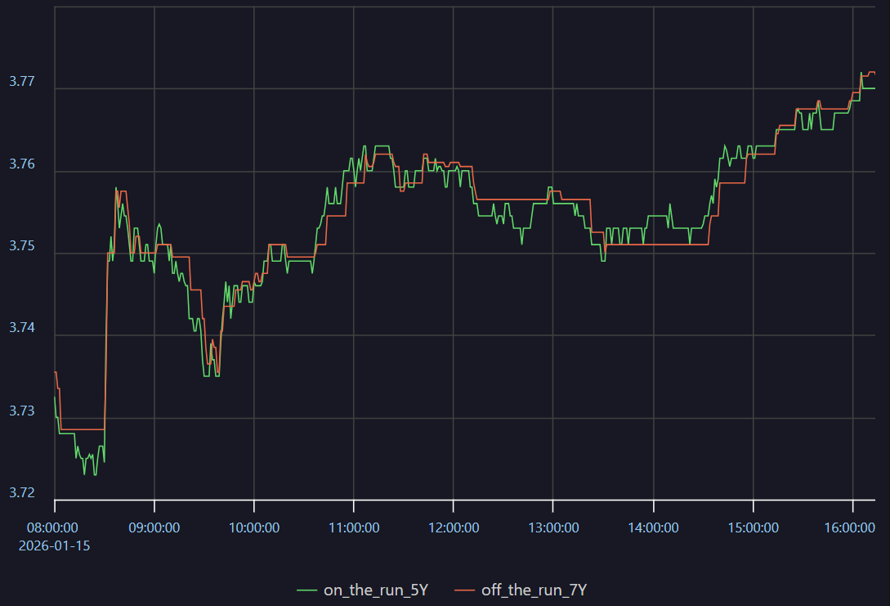
Monitoring a Live Portfolio
Price feeds for many bonds can have gaps between ticks
  This introduces inaccuracies in pricing models, strategy development, execution etc.
  Example (5y Treasuries): The yield on the 7y off-the-run US bond (adjusted +2.5 bp) tracks the yield on the on-the-run 5y bond but updates less frequently
Things to Consider:
  Fast/robust inference for stale bond prices using ticks from frequent bonds?
  How do you distinguish truly idiosyncratic relative movements between frequent and infrequent bonds?
Case Study #1
Evaluating Trading Counterparties
Case Study #2
Evaluating risk through market simulations
Case Study #3
Monitoring a Live Portfolio
Notes:
10yr rate chart

Slide 25
Technology Roles

Slide 26
Roles in Industry
Citadel’s Campus Recruiting team seeks talent across a variety of quantitative and technology focused roles
 | Risk Taking | Financial Math | Coding | Project Management
Trading
Quantitative Research
Quantitative Strategist
Business Analyst
Quantitative Developer
Software Engineer

Slide 27
Q&A
QR Code to connect with our recruiting team:

Slide 28
IMPORTANT NOTICE
This presentation is for the internal use of the recipient(s) only and not for redistribution to potential investors or an offer or solicitation with respect to any securities. Any offer of securities can only be made by a current Confidential Offering Memorandum, which is available on an exclusively private basis and only to qualified financially sophisticated investors. Nothing in this presentation constitutes investment, tax, legal or other advice, and the information contained herein does not purport to represent any investment strategy or product of Citadel.
The information contained in this document is current only as of the date indicated. Citadel has no obligation to update the information following such date and no recipient of the information should rely on such information as current, accurate or complete following such date.

