Slide 1
Lending with alternative data
Paul Gu
Co-founder, Upstart
@paulxgu
1

Slide 2
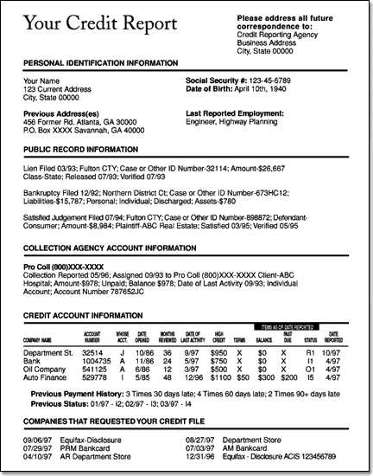
The thin-file problem
?
@paulxgu
2

Slide 3
“
Our results challenge the notion that young borrowers are bad borrowers. We show that young borrowers are among the least likely to experience a serious credit card default.
- Federal Reserve Bank of Richmond
@paulxgu
3

Slide 4
Which group is going to sign up more often?
Risk level of borrower
@paulxgu
4

Slide 5
Major in mathematics
3.86 GPA
2 years work experience
Software engineer
@paulxgu
5

Slide 6
What actually happens when you lend someone money?
83%+
Probability of Paying You Back
@paulxgu
6

Slide 7
Actual credit score distribution
based on FICO (C) 2013 score distribution
@paulxgu
7

Slide 8
r = time value of money
@paulxgu
8

Slide 9
r = time value of money
defaults
volatility
@paulxgu
9

Slide 10
Paying a non-risk free interest rate means you’re covering the cost of other people defaulting.
@paulxgu
10

Slide 11
Ultimate Goal:
Expand access, lower rates
@paulxgu
11

